Slide 1


Managing and sharing research data:
an RDM training course
Part of a Northern Ireland and North East Doctoral Training Partnership (NINE DTP) workshop called "Making the most of your data," held at Durham on 09 July 2019.
Instructor: Nicholas Syrotiuk
http://doi.org/c72v

Slide 2

Session
plan
Data management planning [1]
Managingactive data [2]
Sharing & preservingdata [3]
Re-using research data [4]

Slide 3
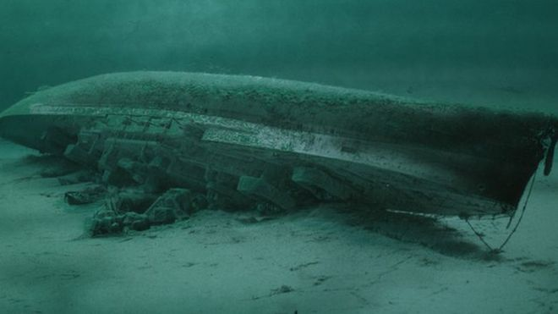

2019/01/28: Reward for stolen Royal Oak wreck data laptop
Why bother with RDM?

Slide 4
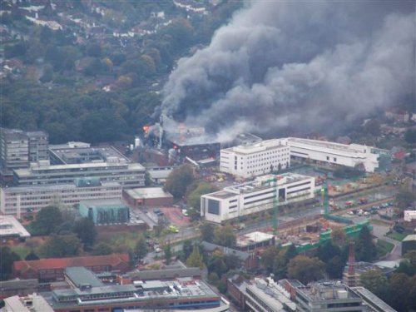
2005/10/30:
Fire destroys Southampton research centre
Notes:
Gas canisters exploded inside the Mountbatten building on Salisbury Road, Highfield, which was engulfed by a 100ft plume of smoke on Sunday morning.
No-one was hurt but the building, which housed valuable equipment for research, was gutted.
It has been estimated that the fire caused £50m worth of damage.
A spokesman said some of the world's most advanced research was carried out there and its loss was devastating.
The laboratory, part of the school of Electronics and Computer Science, was completely destroyed, and a nearby office building was damaged.

Slide 5
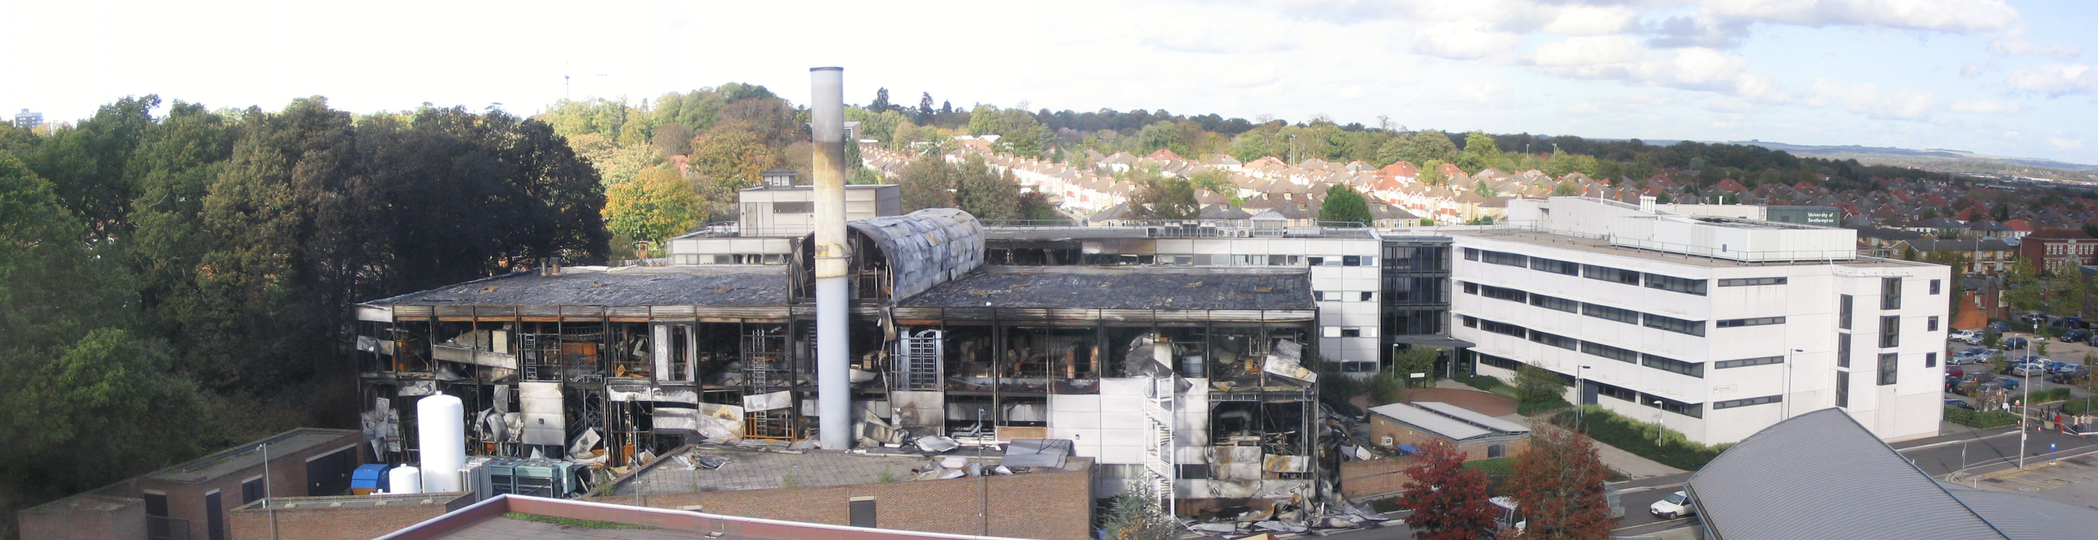
Estimated damage to Mountbatten Building: £50 million

Slide 6
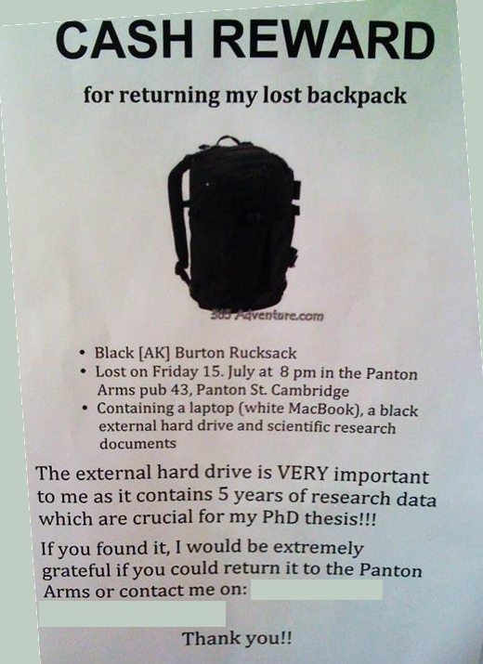
F I V E years of research data lost
Photograph by P. Murray-Rust is licenced under CC-BY.

Slide 7
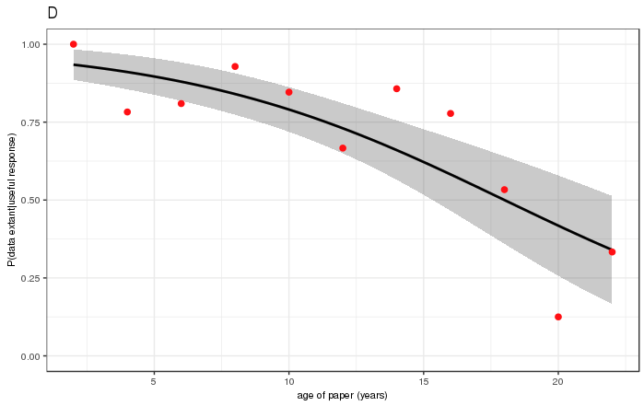
"Availability of research data declines rapidly with article age"--Vines et al.
Data extant (percent)
Age of paper (years)
Image created by N Syrotiuk from the orignal research data and R script.

Slide 8
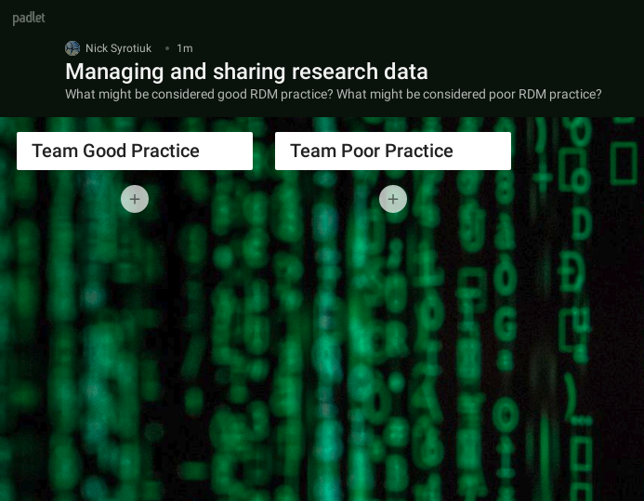
Interactive session
https://padlet.com/sefnyn/rdm

Slide 9
Part one:
DATA
MANAGEMENT PLANNING

Slide 10
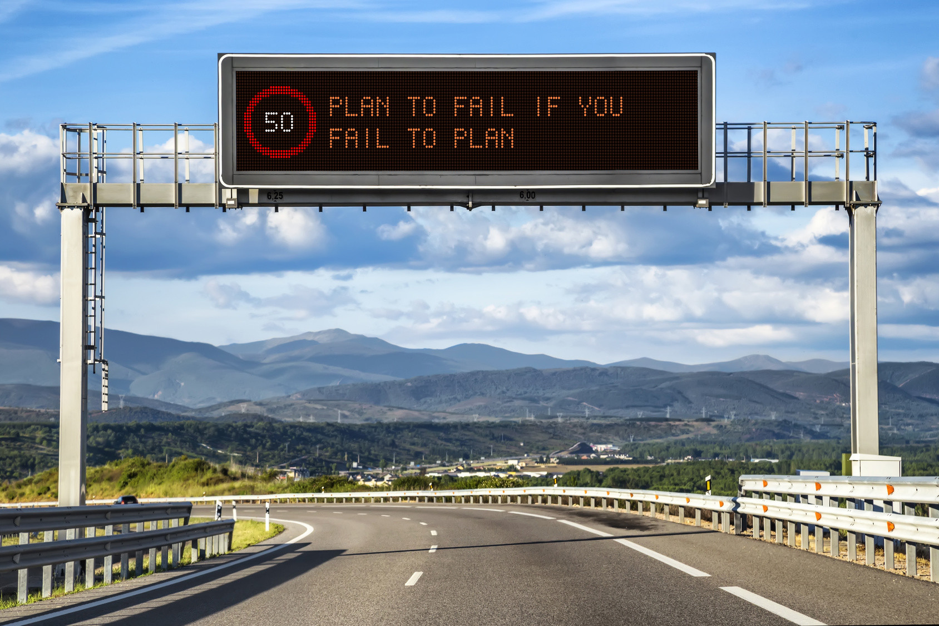
Notes:
- You are more likely to meet objectives if you plan
- Good research habits lead to longer preservation of research data (less data loss)
- Planning leads to better communication with collaborators, professional support staff and funders

Slide 11
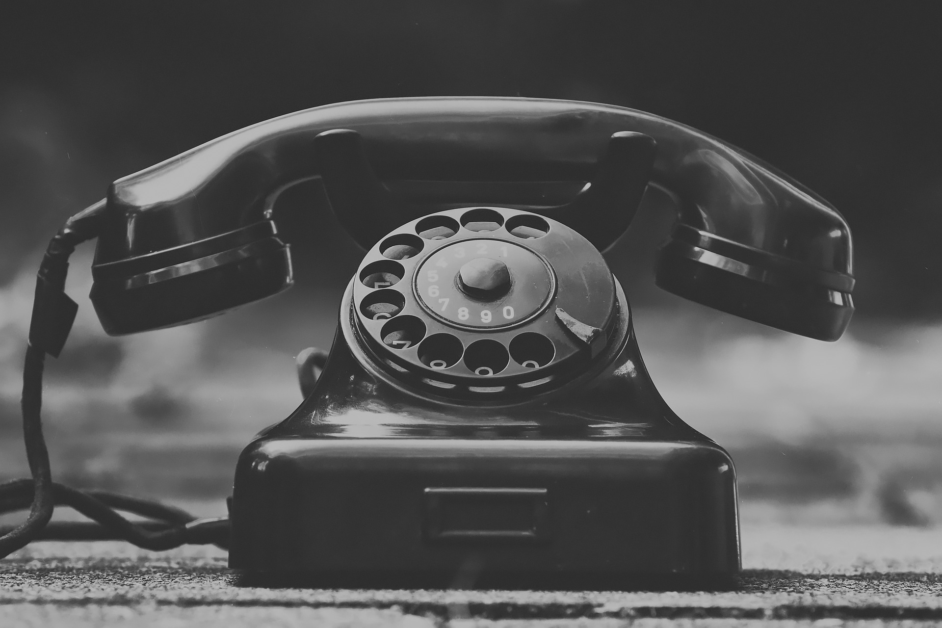
DMP document: a communication tool

Slide 12

Objectives

Slide 13
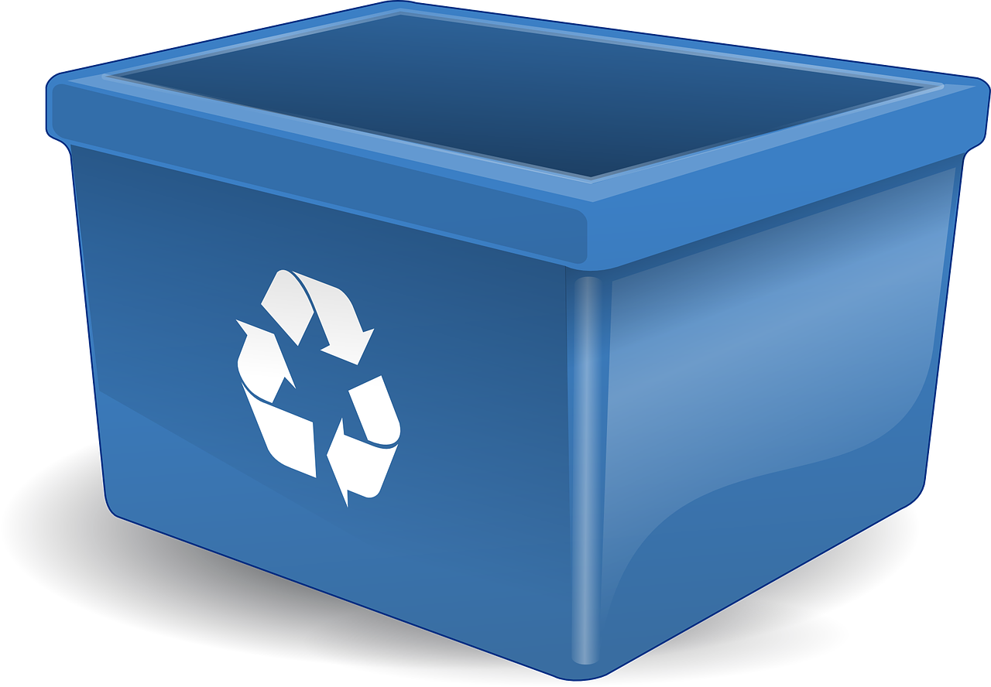
Maximise RE-USE potential of data

Slide 14
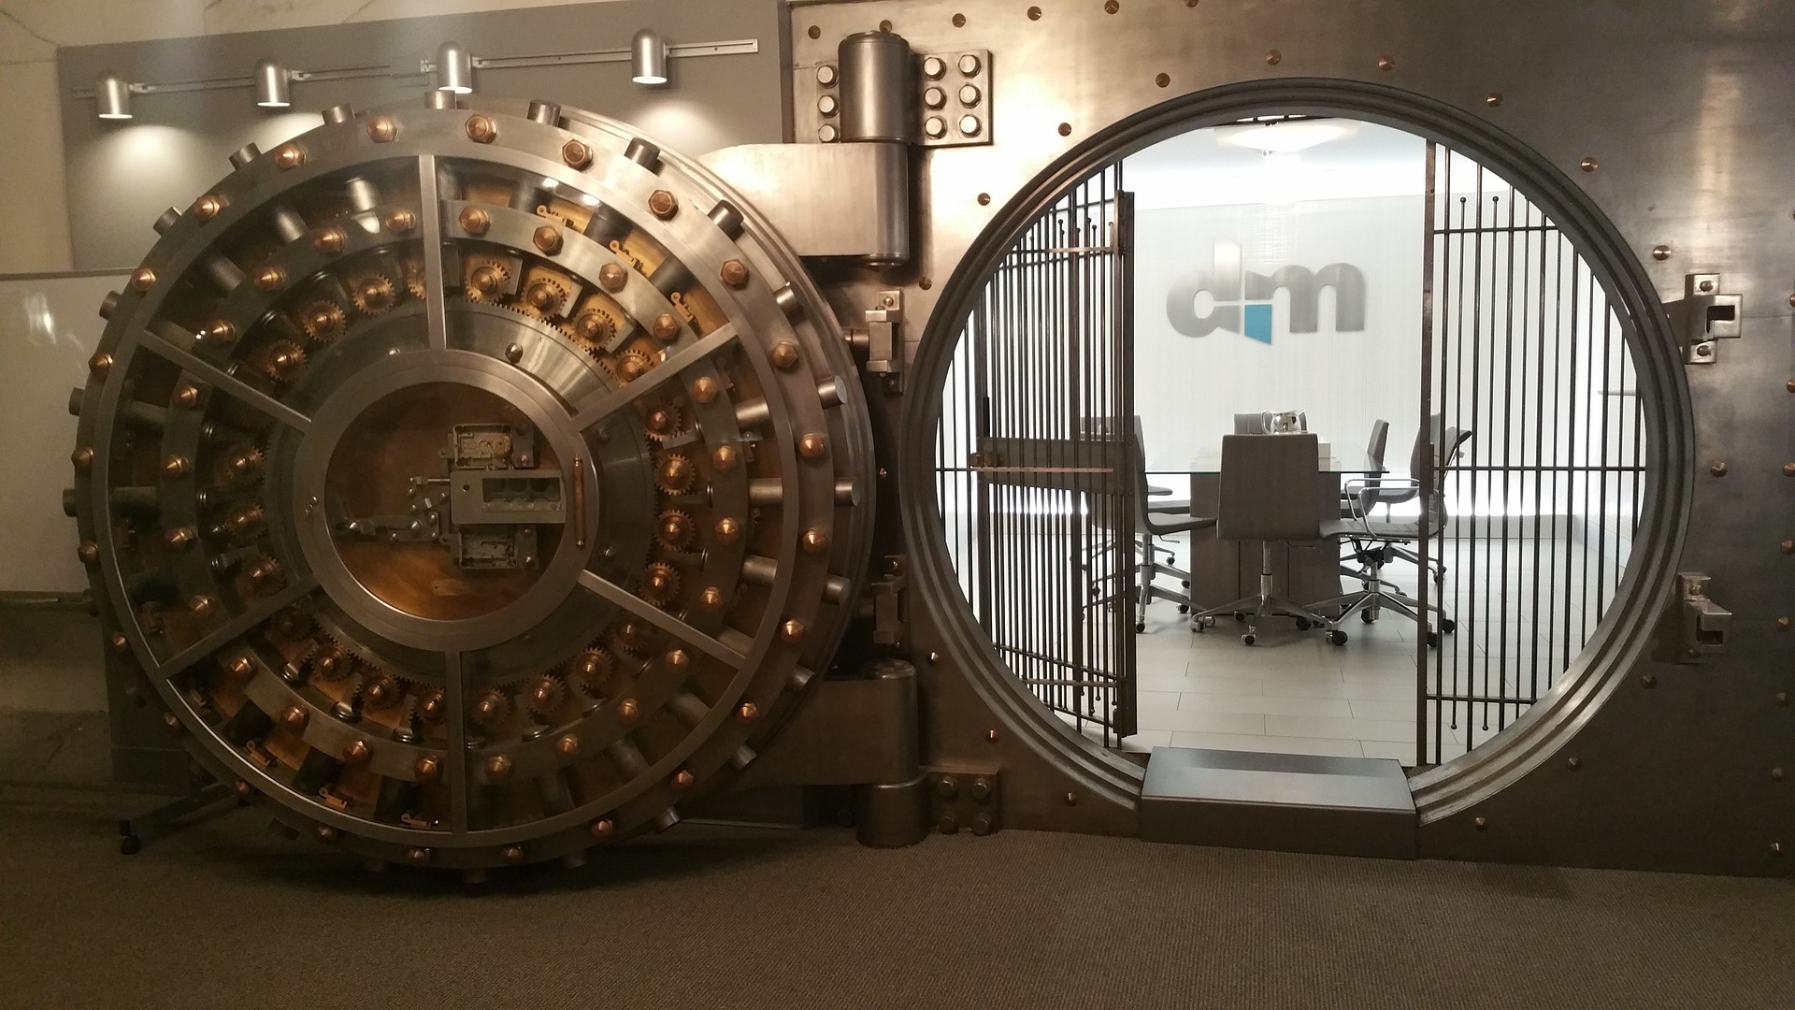
Keep sensitive data SAFE

Slide 15
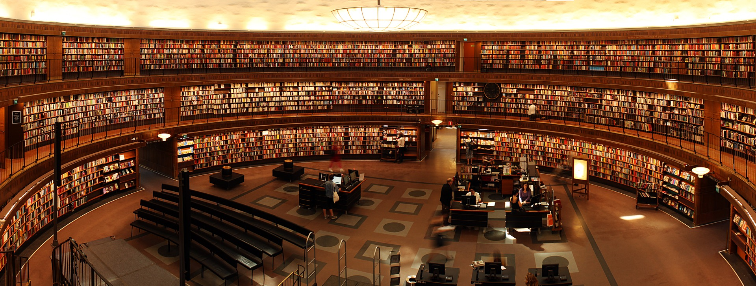
PRESERVE data for longer

Slide 16
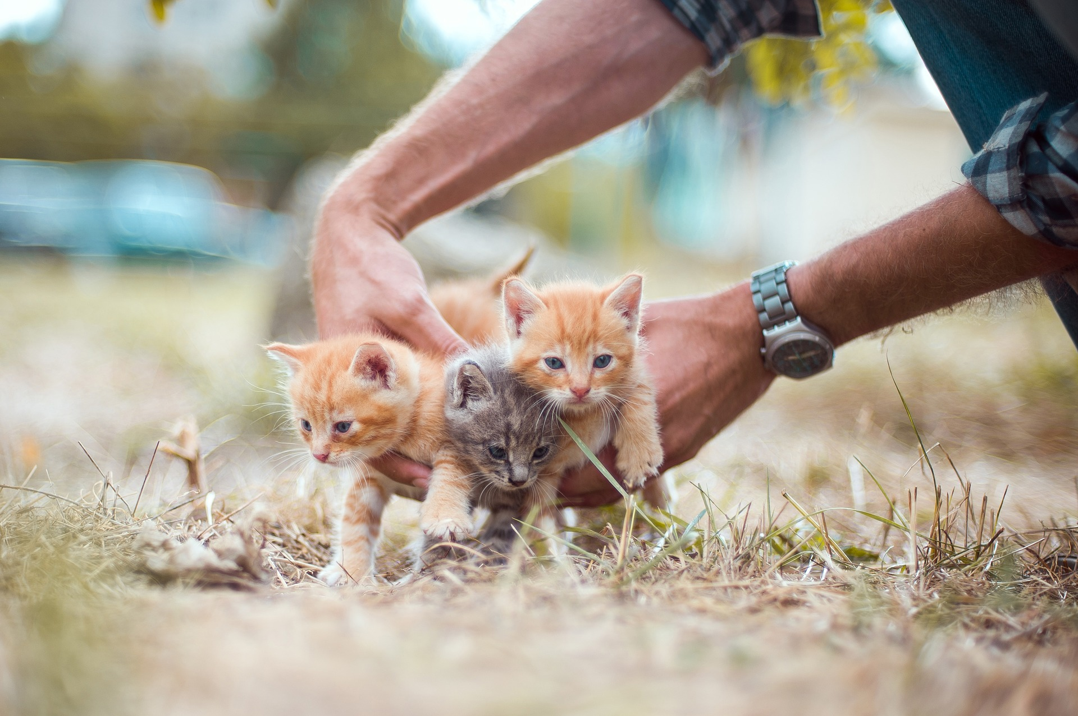
Cute kittens ...

Slide 17
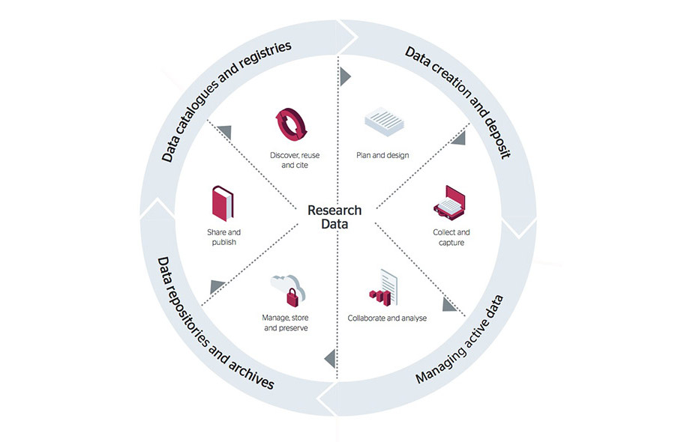
Research data lifecycle provides structure for DMP
Diagram by Jisc is licenced under CC BY 4.0

Slide 18
Data creation

Slide 19
Data analysis

Slide 20
Data deposit

Slide 21
Data dissemination

Slide 22
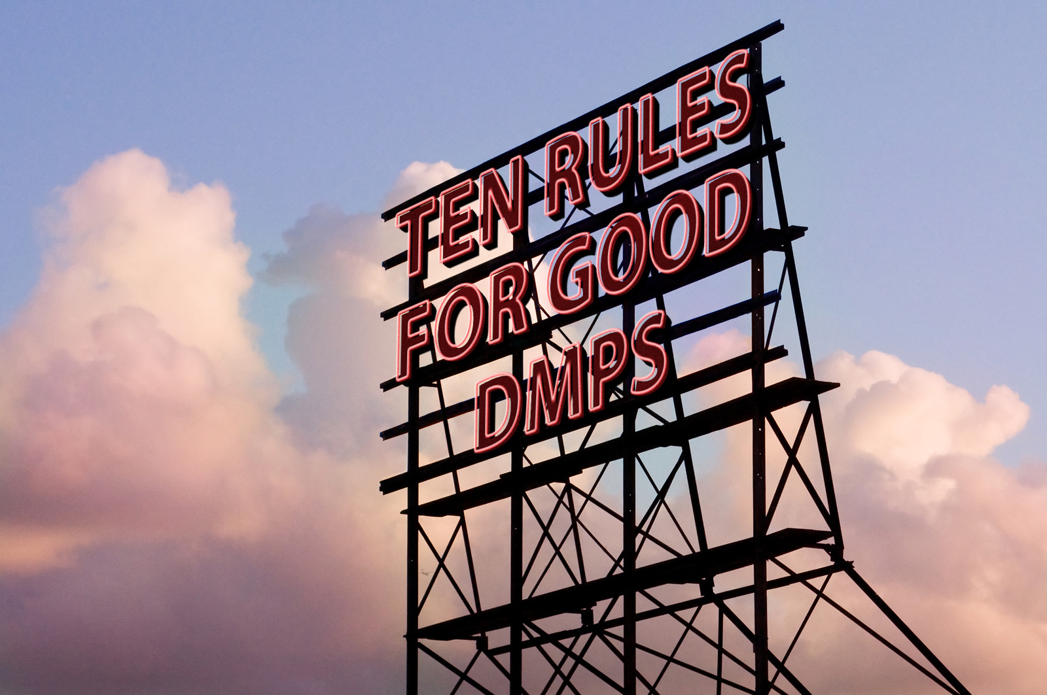

Slide 23
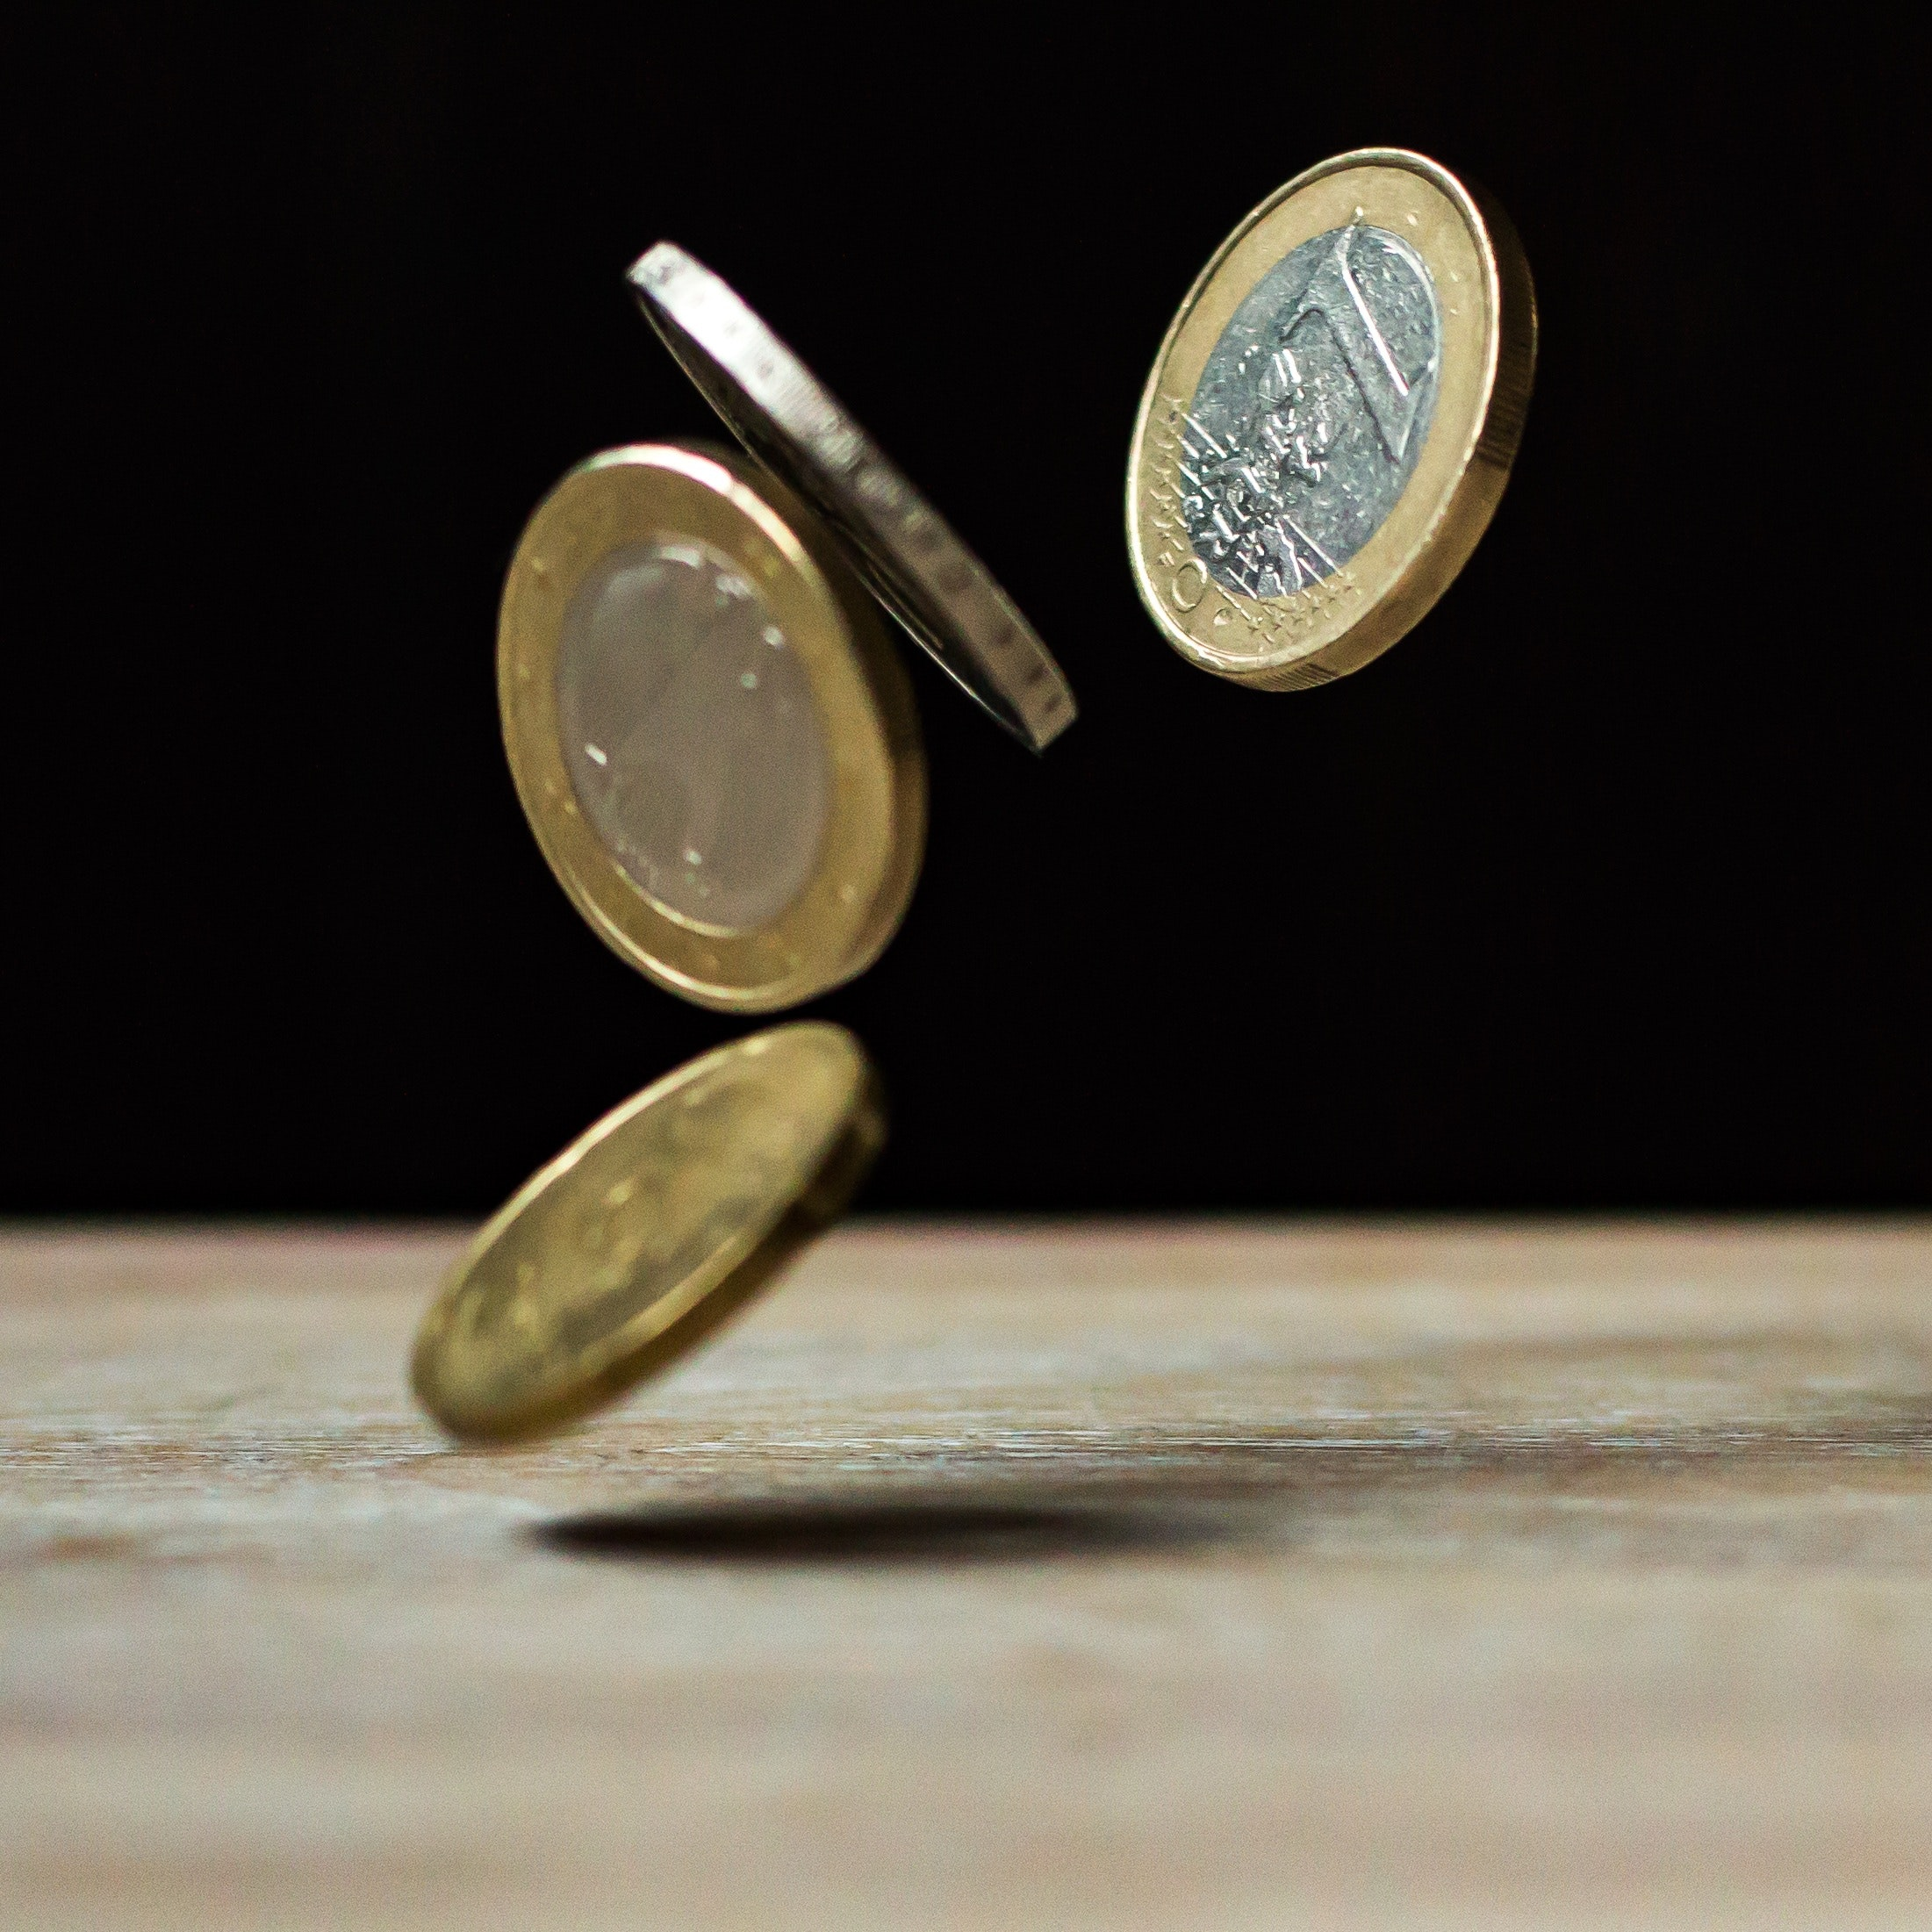
1. Determine FUNDER
requirements

Slide 24

2. IDENTIFY the data to
be collected
Types of data
Methods of data collection
Volume of data in bytes
File formats: open preferred

Slide 25

3. State how data will be ORGANISED

Slide 26
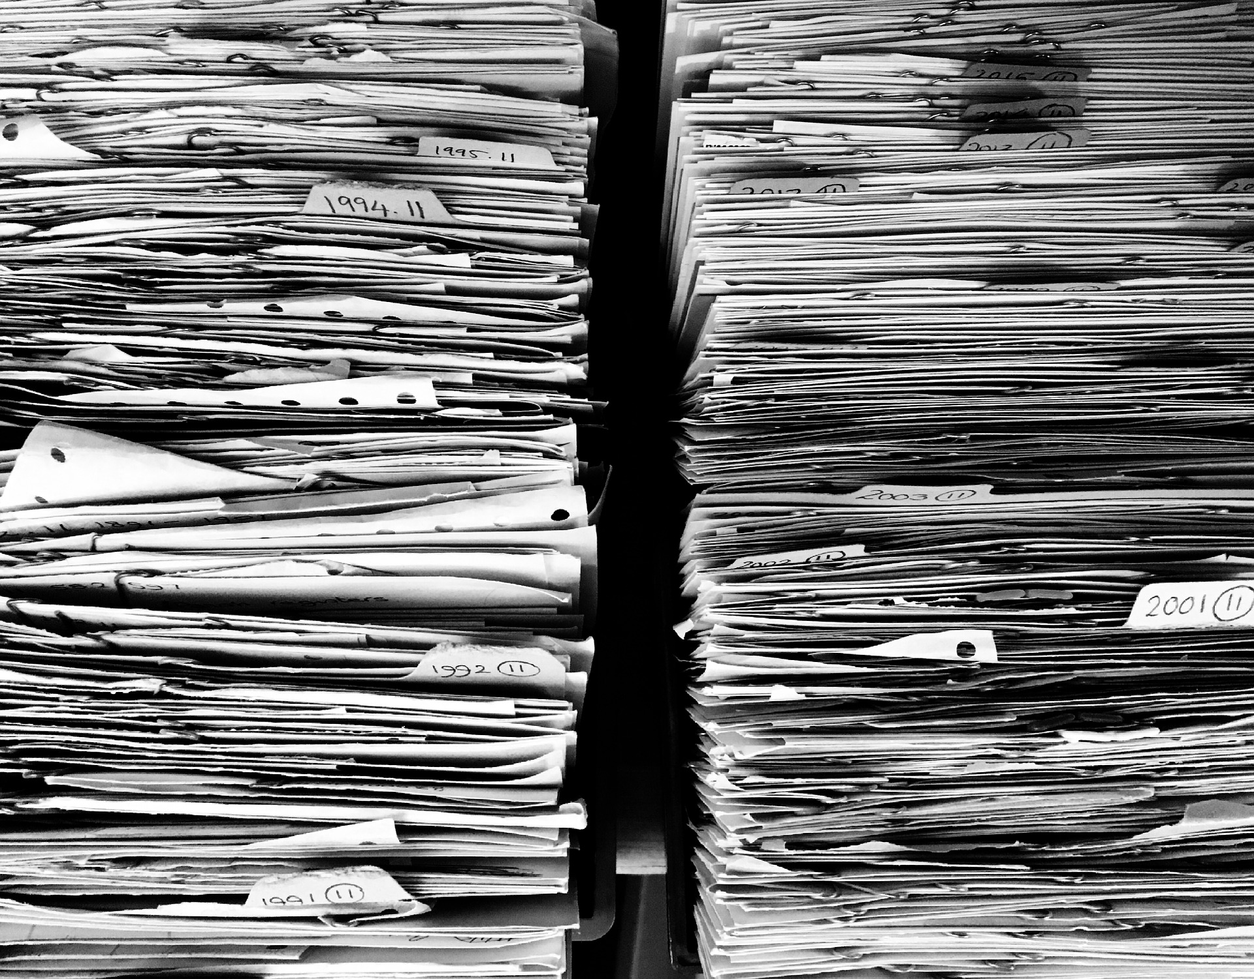
4. Explain how data will be DOCUMENTED

Slide 27

5. Describe how
data QUALITY will be assured

Slide 28

6. Provide a solid STRATEGY for data storage and preservation

Slide 29
7. Define the project's data POLICIES
Data (and software) licencing
Plans for sharing. Embargo?
Management of sensitive data

Slide 30

8. Describe how data will be DISSEMINATED

Slide 31

9. Assign ROLES and RESPONSIBILITIES

Slide 32
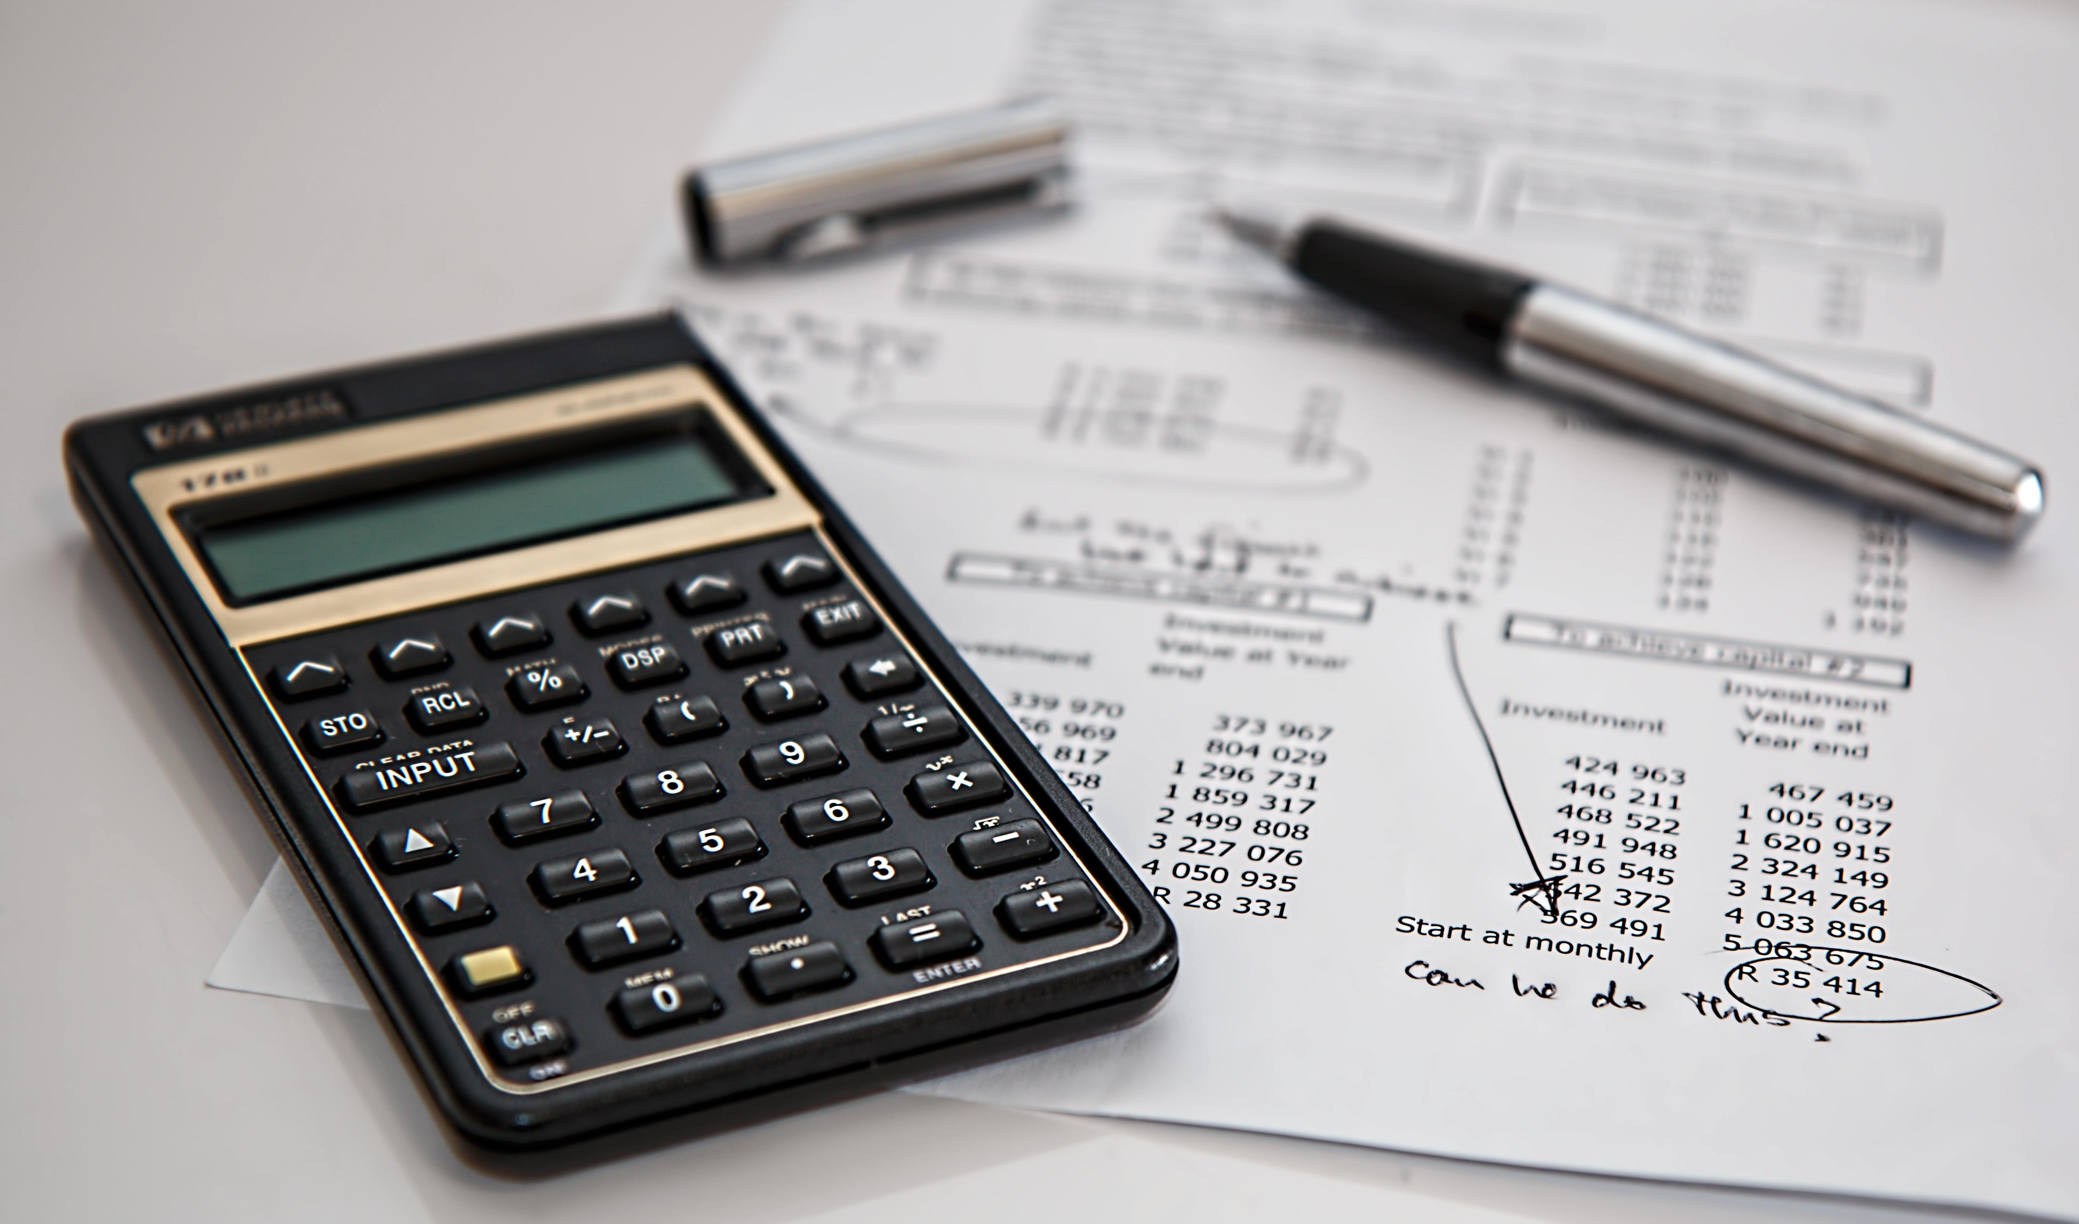
10. Prepare a realistic B U D G E T

Slide 33
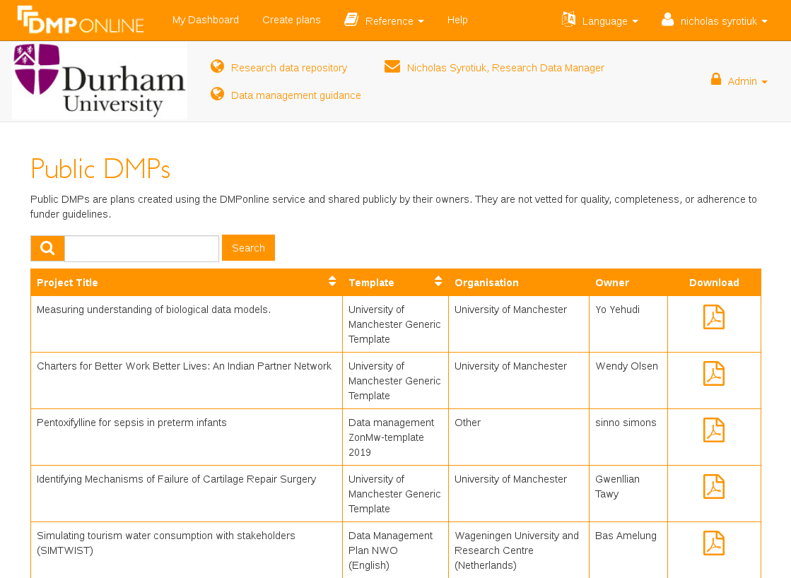

1. Choose funder template
2. Write detailed plan
3. Share plan
https://dmponline.dcc.ac.uk

Slide 34
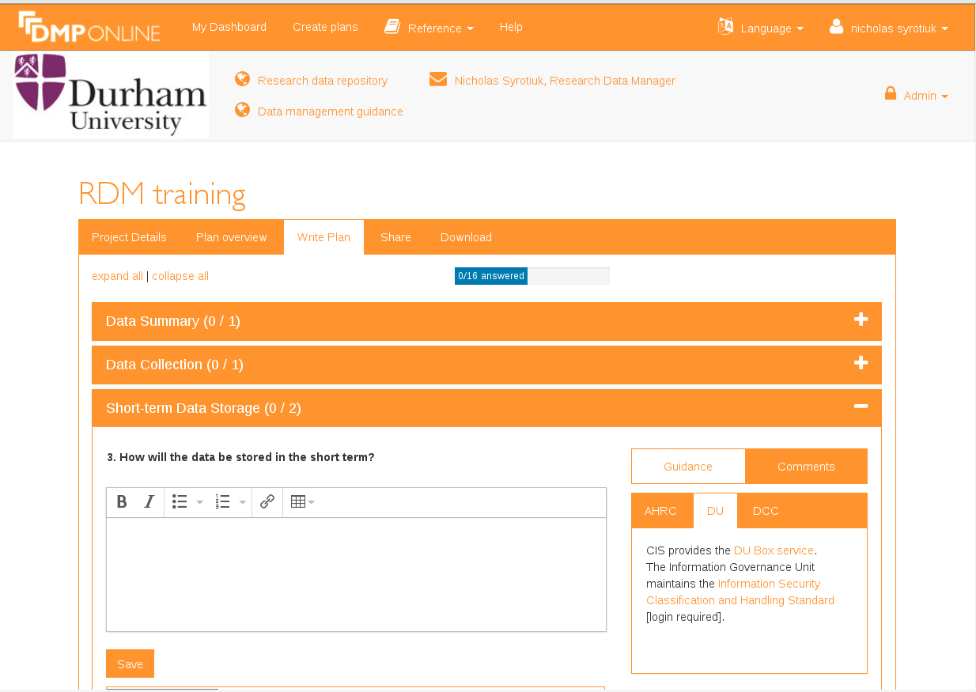
Guidance

Slide 35
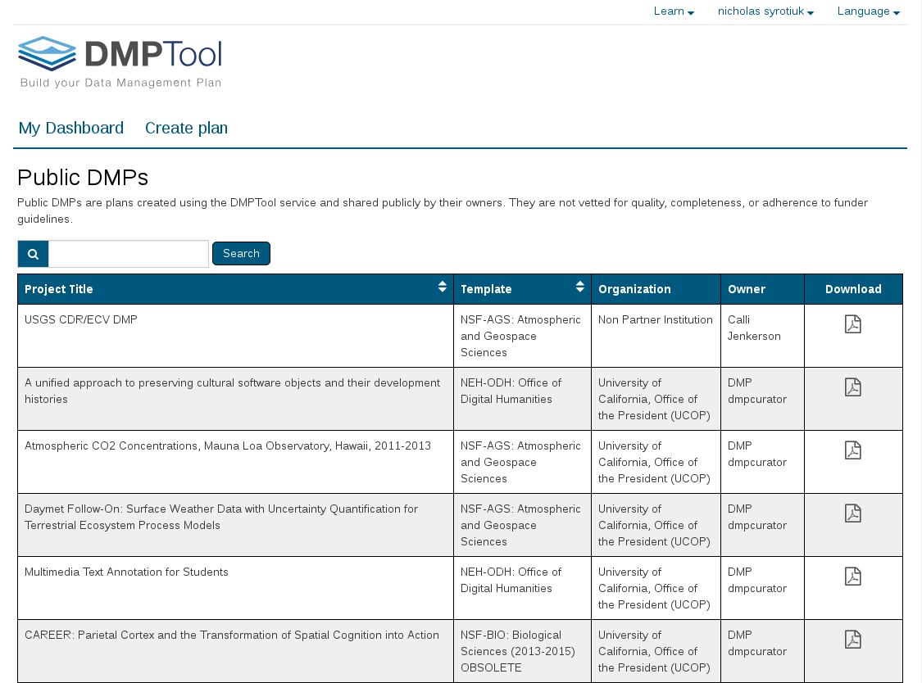

https://dmptool.org

Slide 36
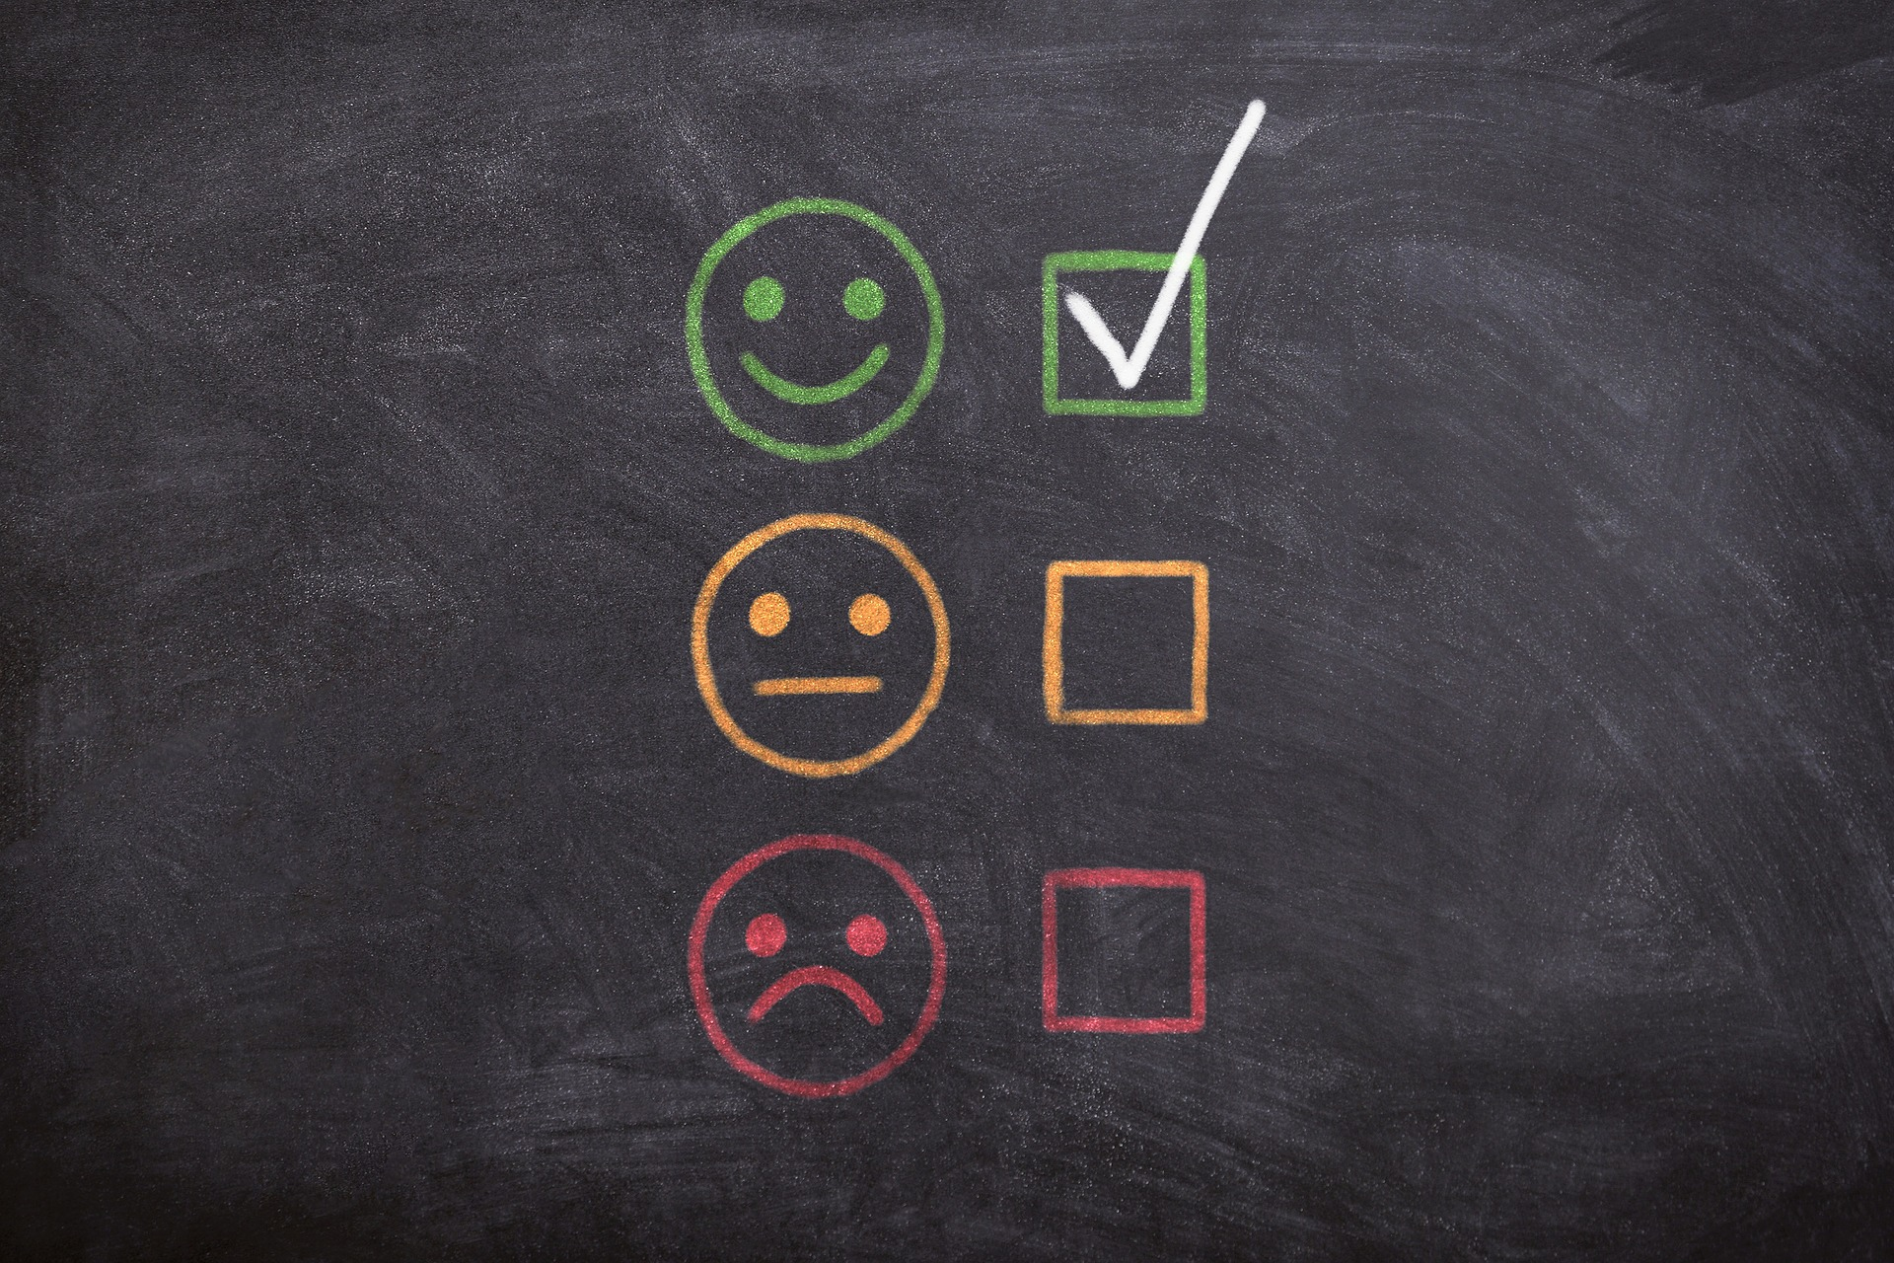
D
M
P
R
E
V
I
E
W

Slide 37

Data security
Data encryption
Strict user access permissions
Hardware and software firewalls

Slide 38
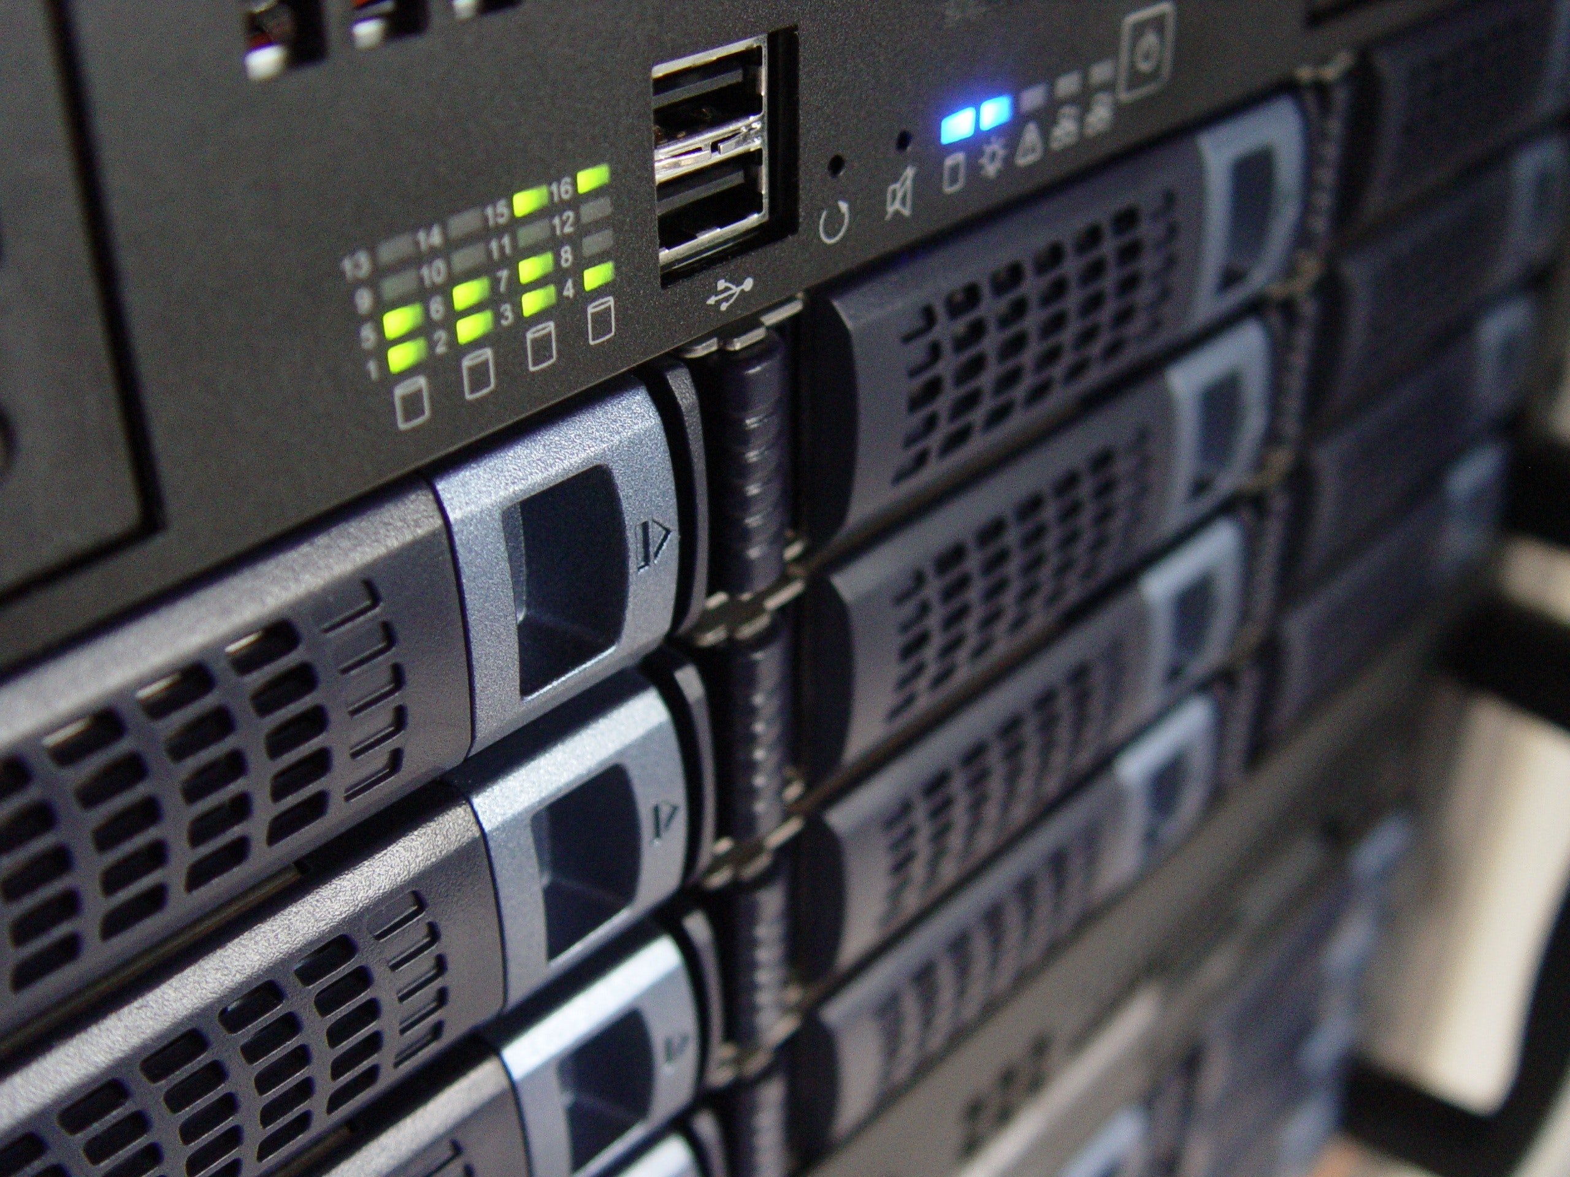
The Future:
machine-actionable DMP = maDMP

Slide 39

Dynamic DMPs

Slide 40

Interoperable DMPs: to exchange information between research systems

Slide 41

Persistent identifiers in DMPs
ORCID IDs
Funder IDs
Grant IDs
Org IDs
Repo IDs
DOIs

Slide 42

Public DMPs

Slide 43
Part two:
MANAGING
ACTIVE
DATA

Slide 44
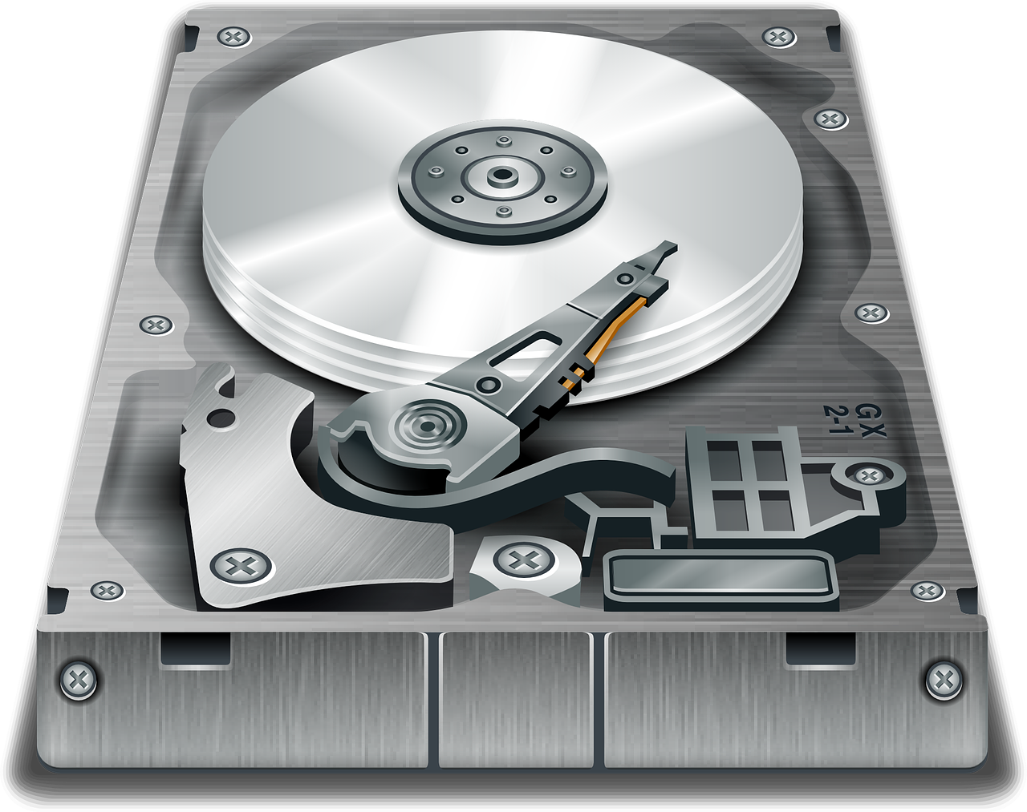

Personal
Research
Storage

Slide 45

Shared
Research
Storage

Slide 46
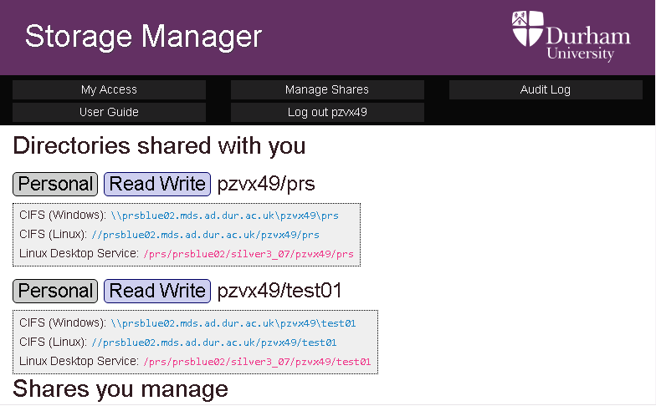

Slide 47
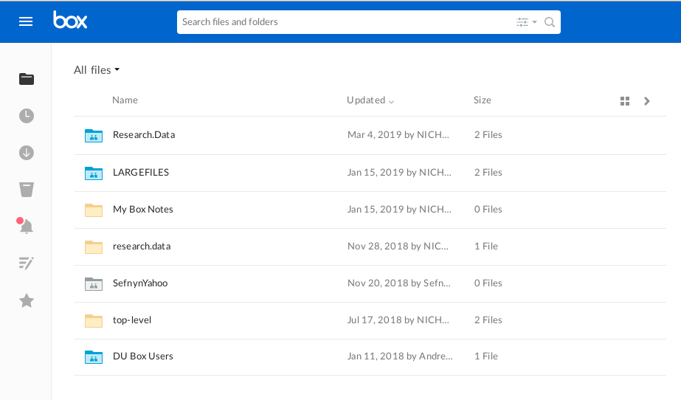
Durham University (DU) Box:
Cloud storage for research

Slide 48





Dropbox
Google drive
Apple iCloud
Microsoft Onedrive

Slide 49
Part three:
SHARING &
PRESERVING
DATA

Slide 50
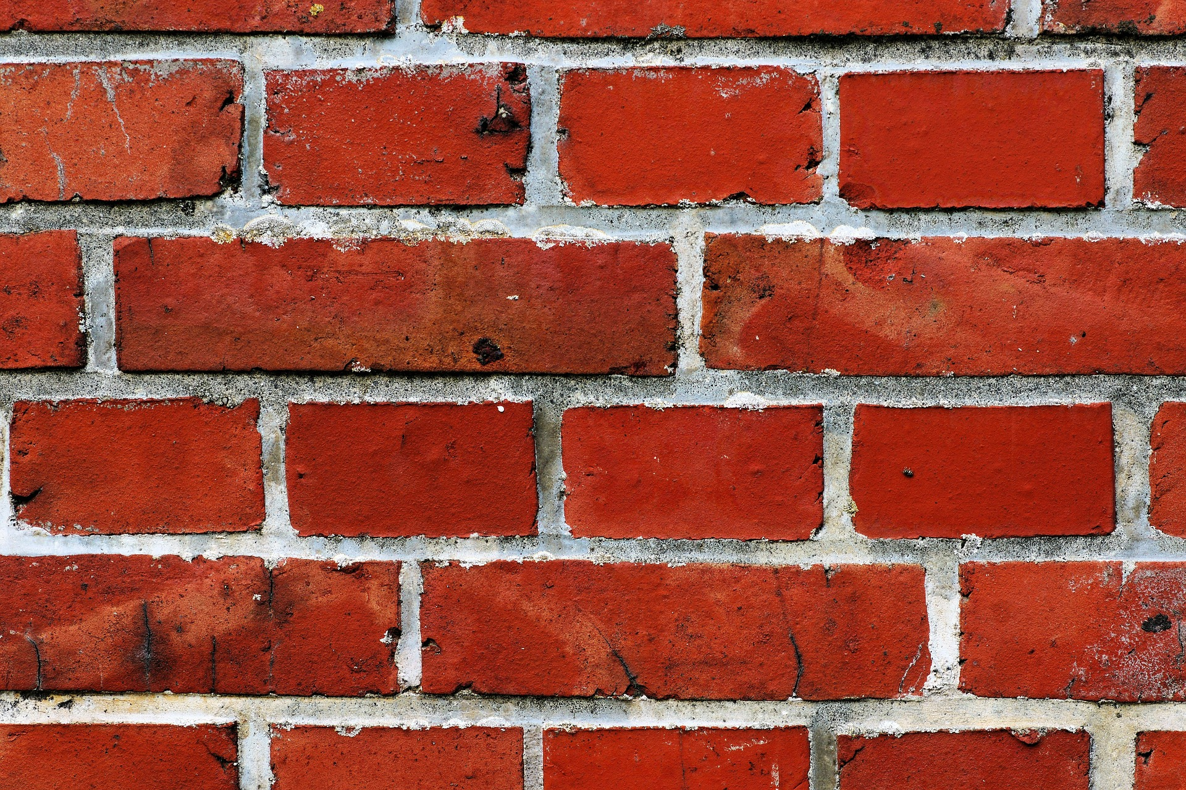
Barriers to sharing

Slide 51
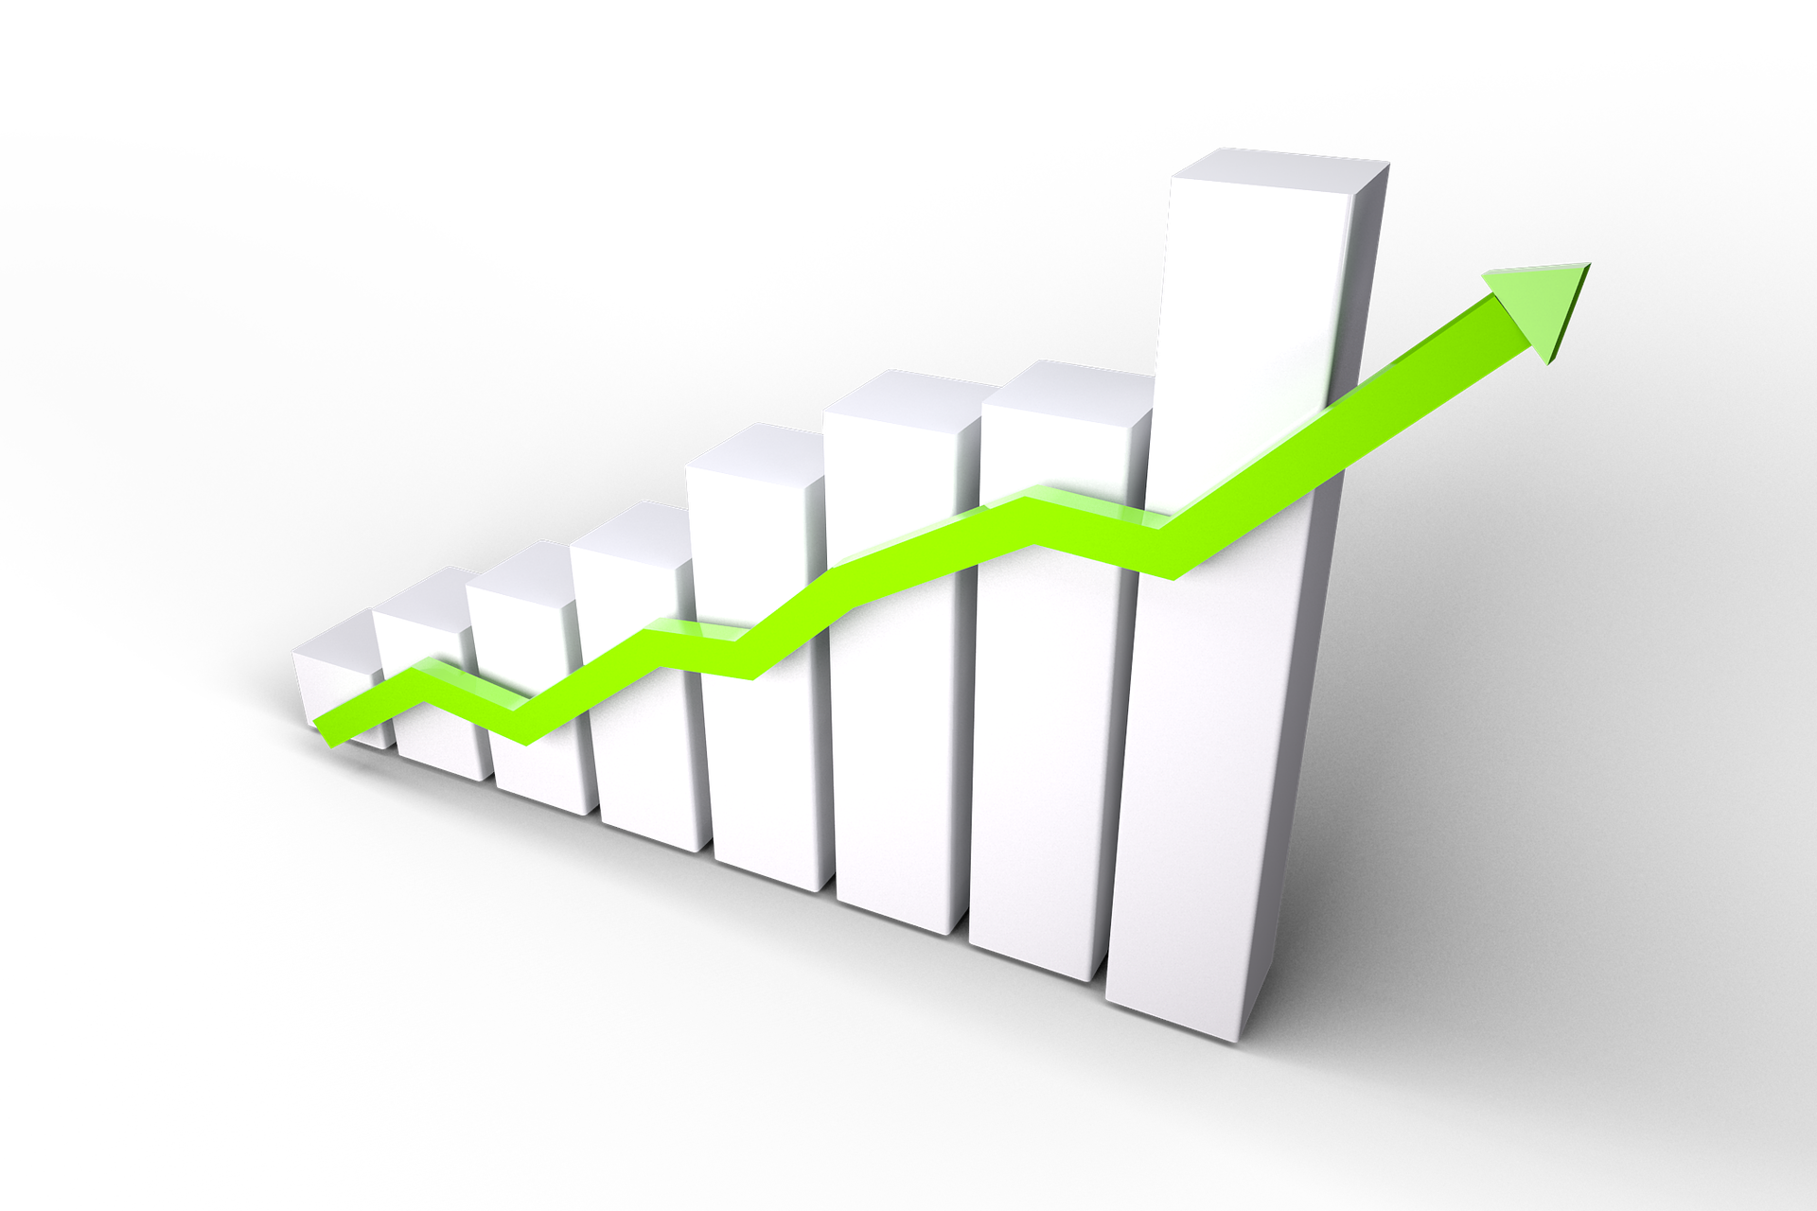
"69 % increase
in citations" -- Piwowar et al.
Benefits of sharing

Slide 52
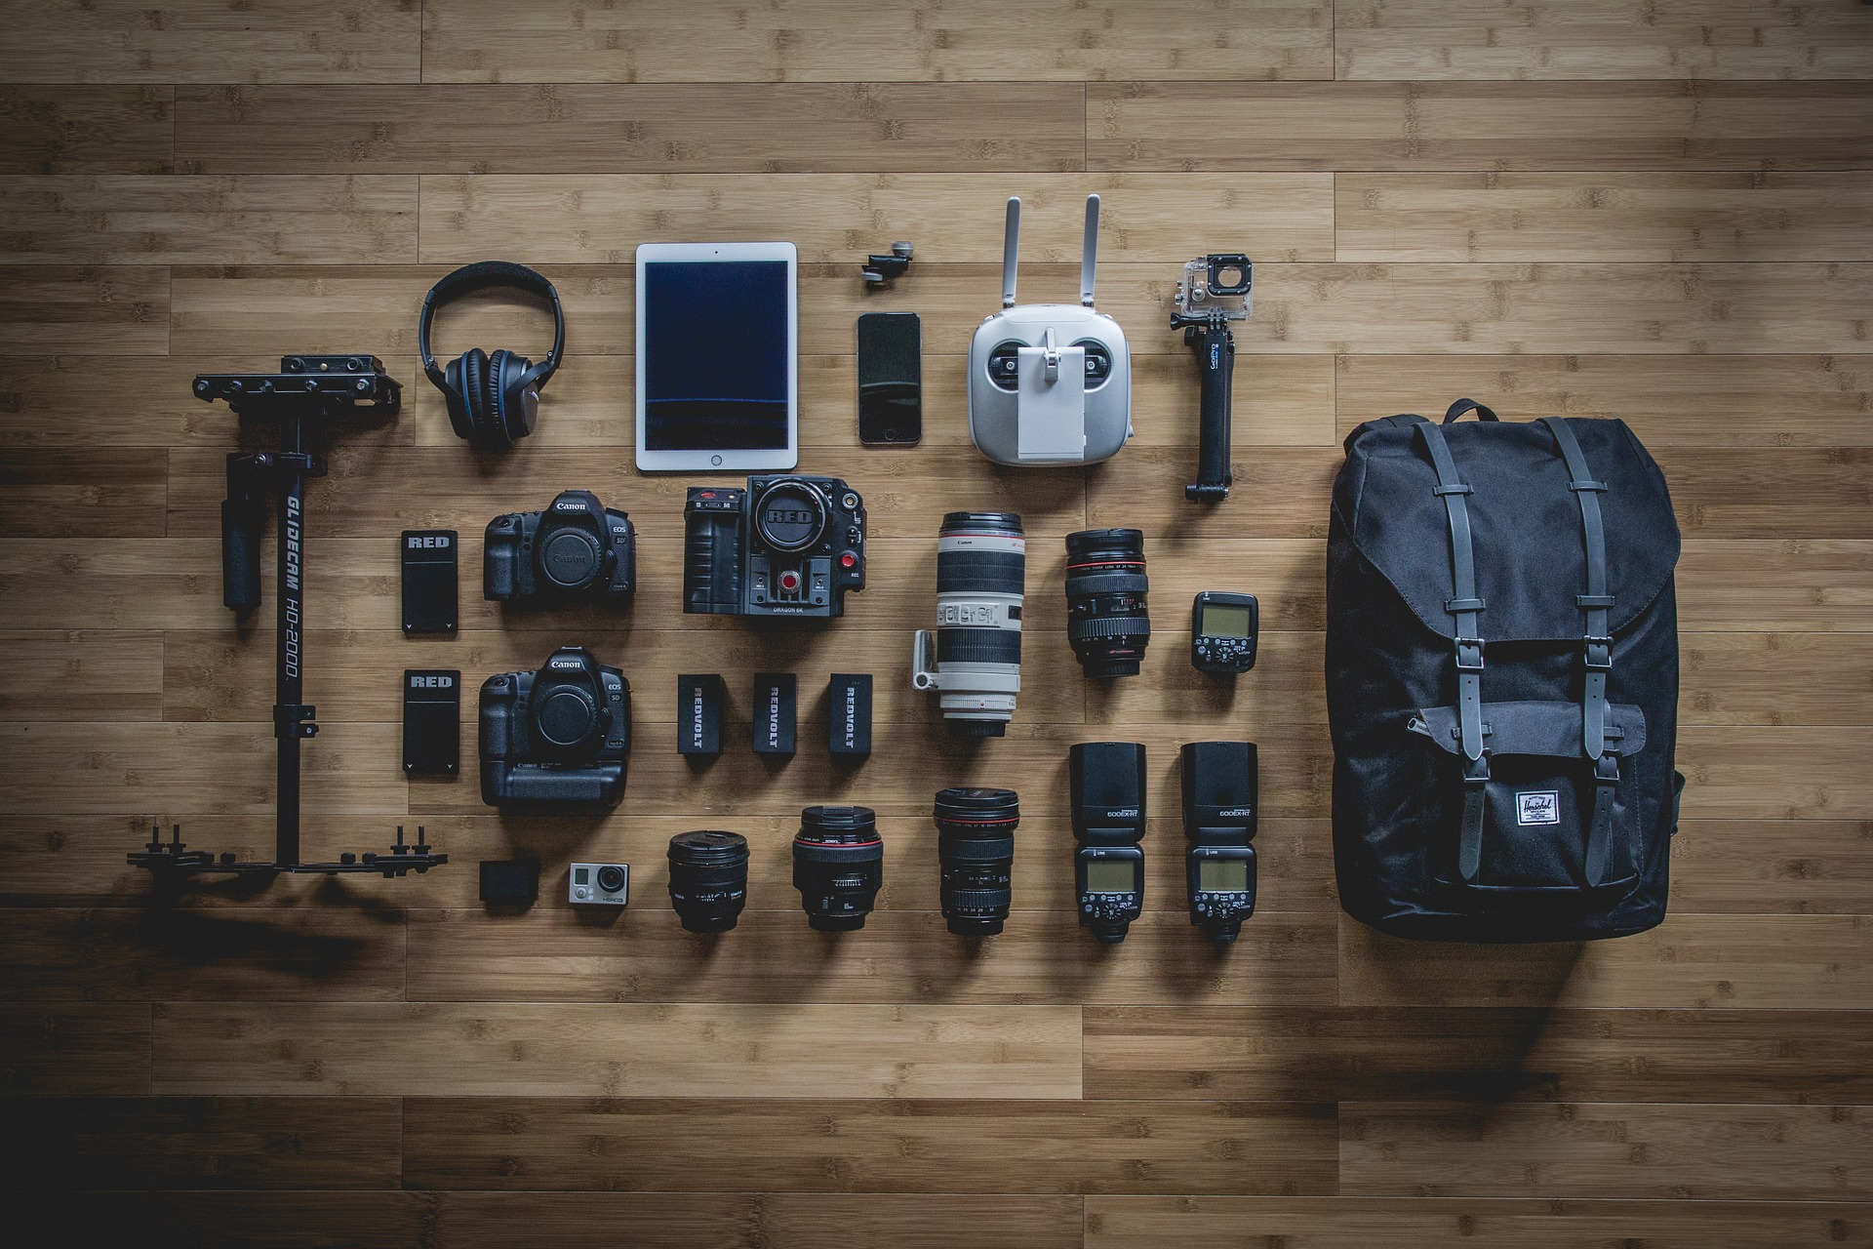
Preparation and organisation
Provide all necessary files
Ensure accessibility of files
Descriptive file names
Logical file structure

Slide 53
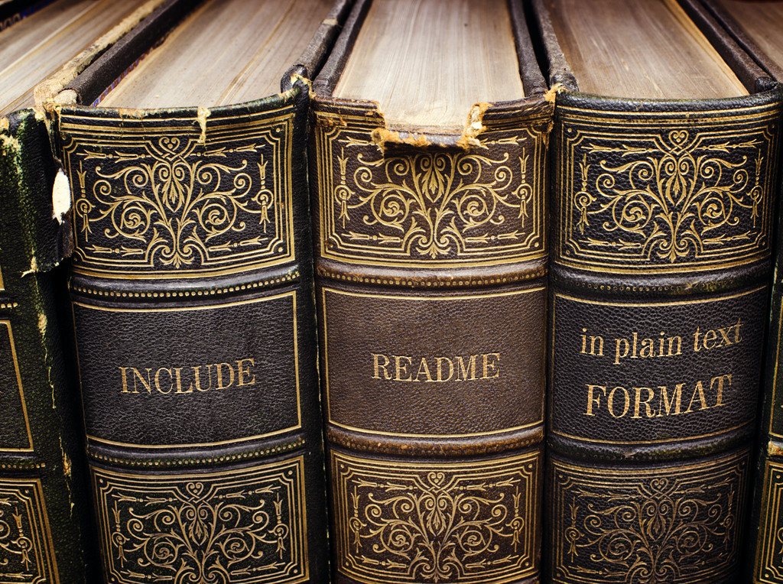

Slide 54
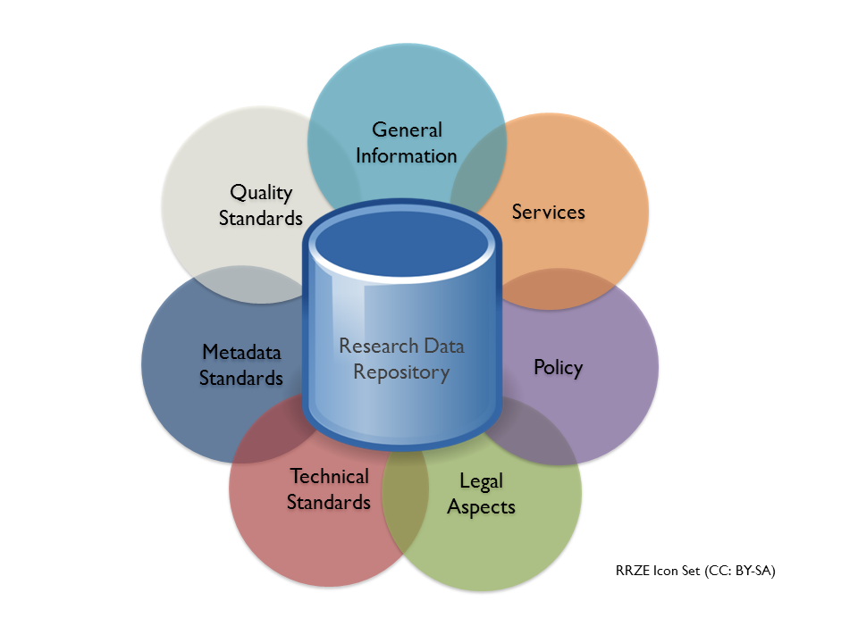
Data deposit
Illustration by Pampel, Vierkant, Scholze, Bertelmann, Kindling, Klump et al is licenced under CC BY SA. DOI: 10.1371/journal.pone.0078080 (pre-print).

Slide 55
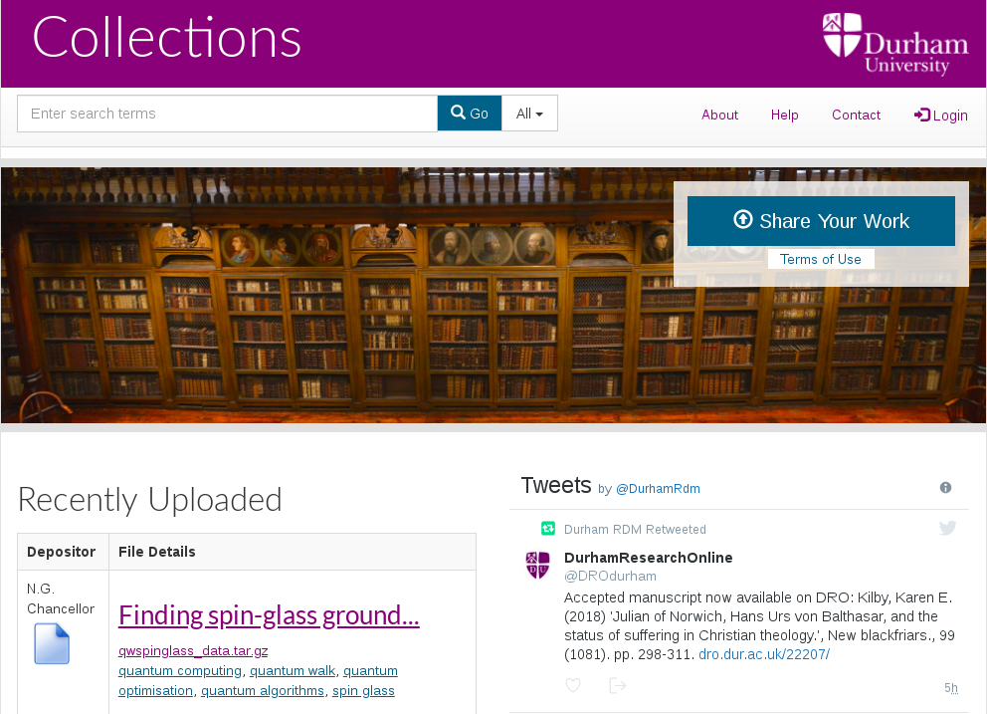
Durham research data repository

Slide 56


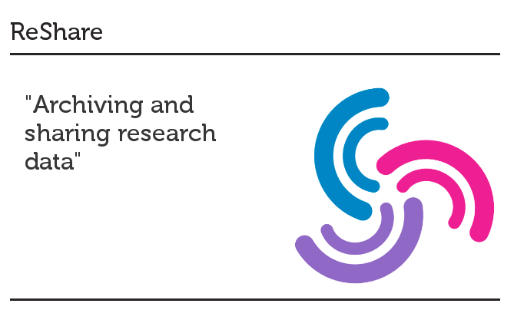
Data review procedures

Slide 57
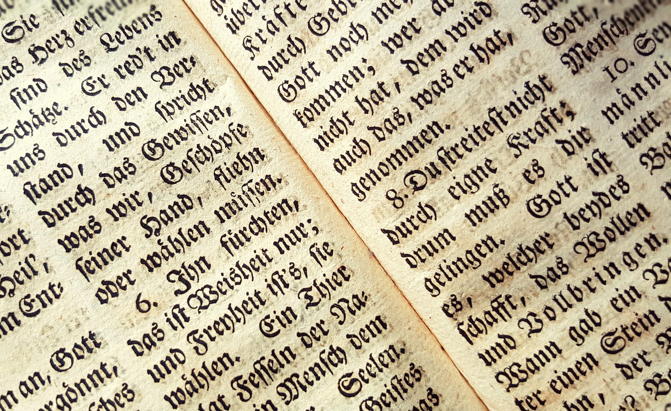
Data citation
Format:
Creator (PublicationYear): Title. Version. Publisher.
(resourceTypeGeneral). Persistent identifer
Example:
Breckon, T; Tiancheng, G (2018): Pretrained neural network models for Guo 2018 study, TensorFlow format. Durham University. (dataset).
DOI: http://doi.org/10.15128/r23j333226h
Source: Metadata Schema Documentation for the Publication and Citation of Research Data, version 4.1. DOI: http://doi.org/10.5438/0014

Slide 58
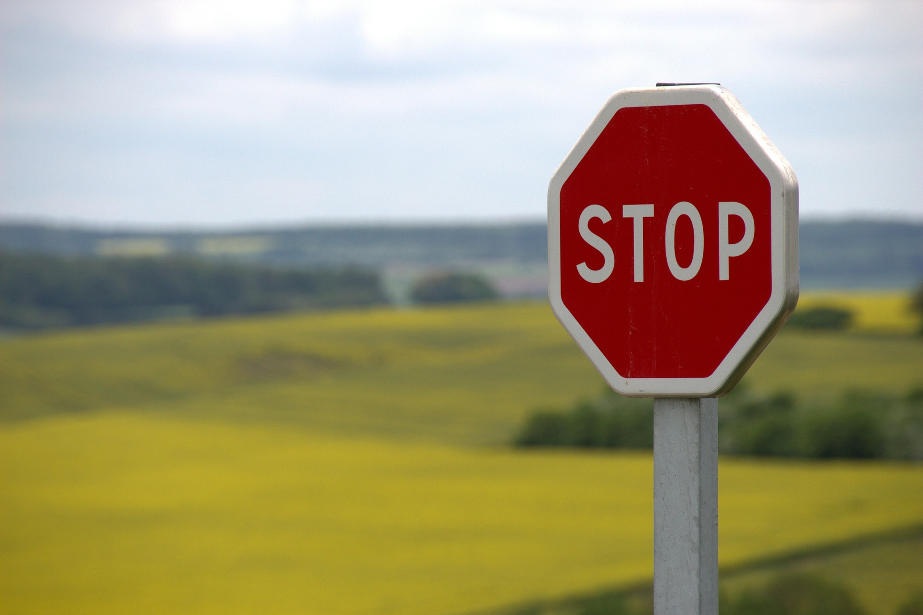
Exceptions to sharing
Ethical reasons
Public safety reasons
Commercial reasons

Slide 59
Part four:
RE-USING
RESEARCH
DATA

Slide 60
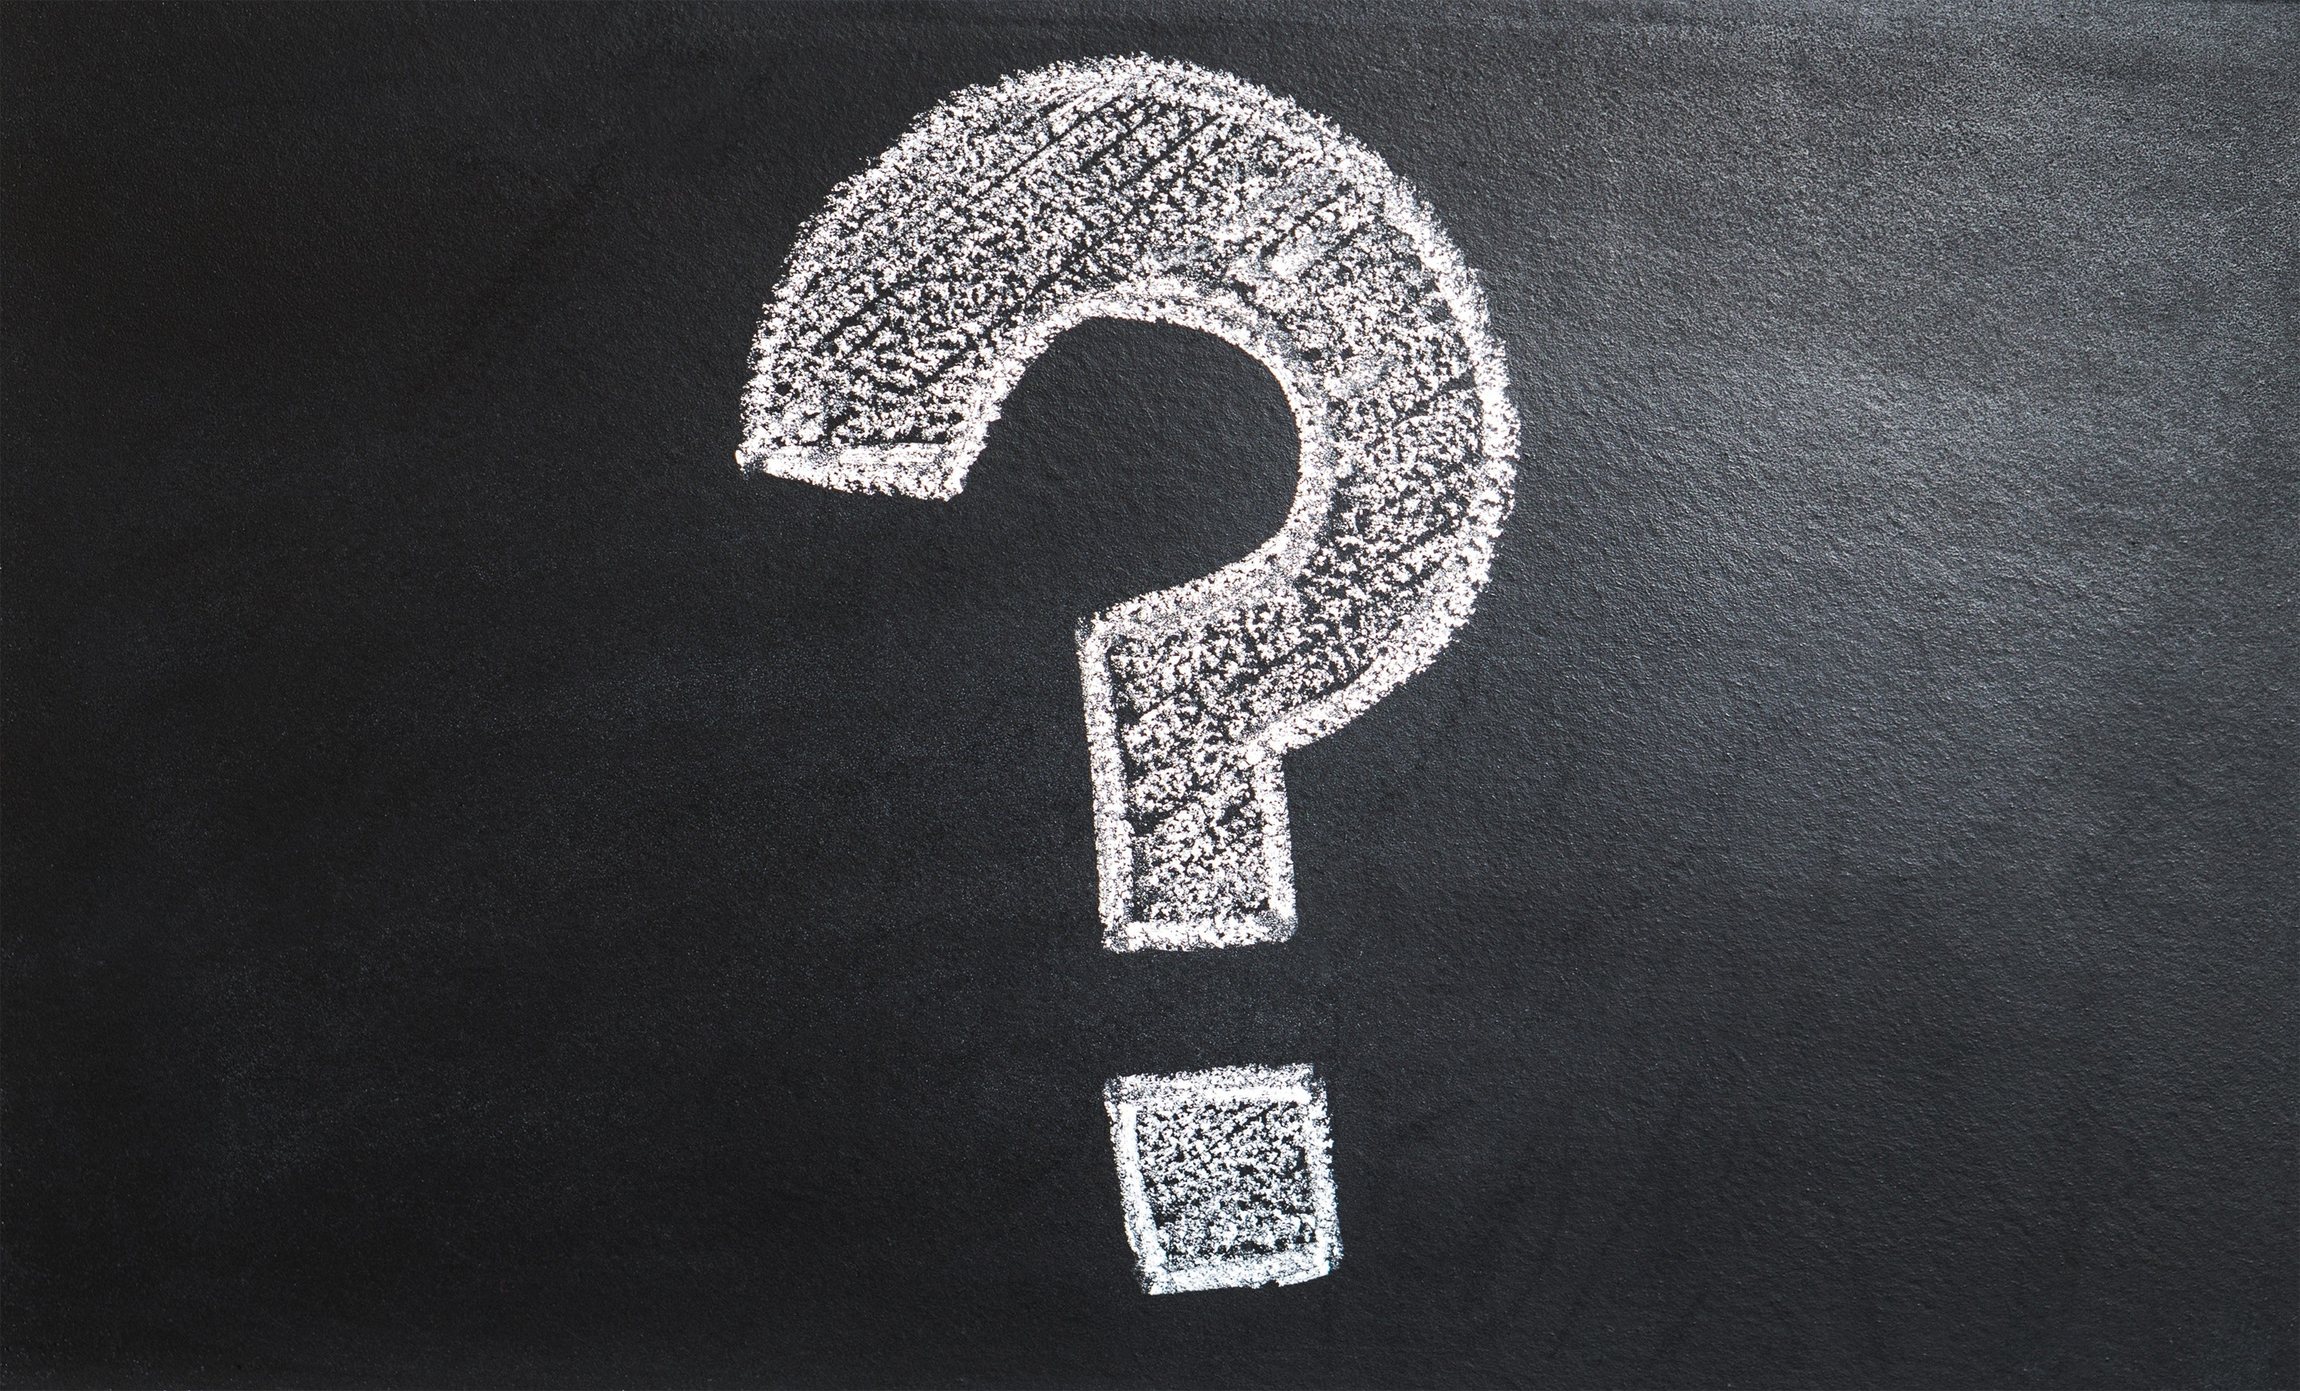
Data re-use #1
Answer new question from existing data

Slide 61
Data re-use #2
Combine data with other existing data
A + B = C

Slide 62
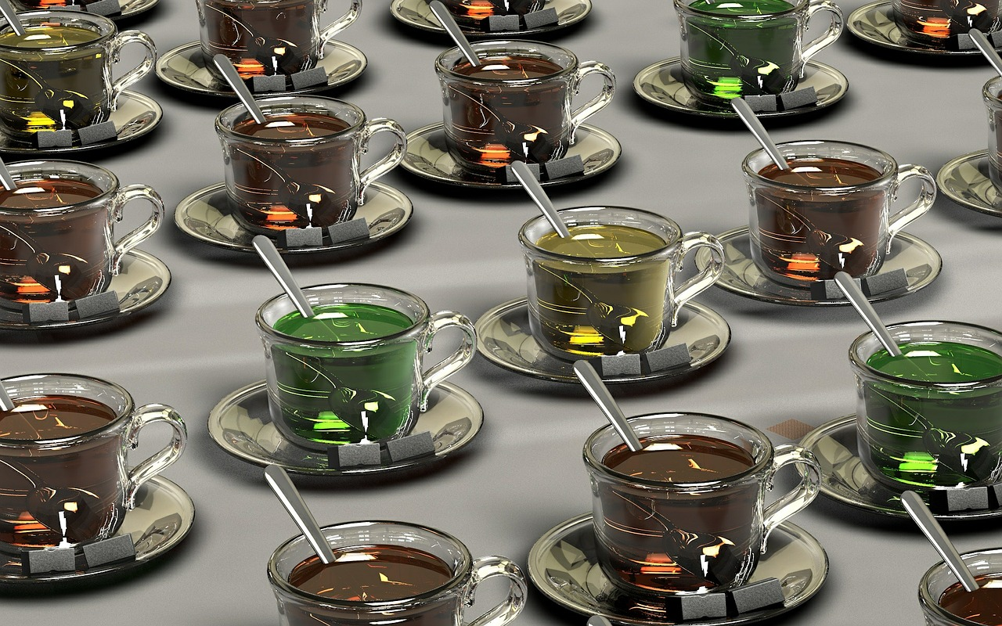
Data re-use #3
Reproduce or replicate the results of a prior study

Slide 63
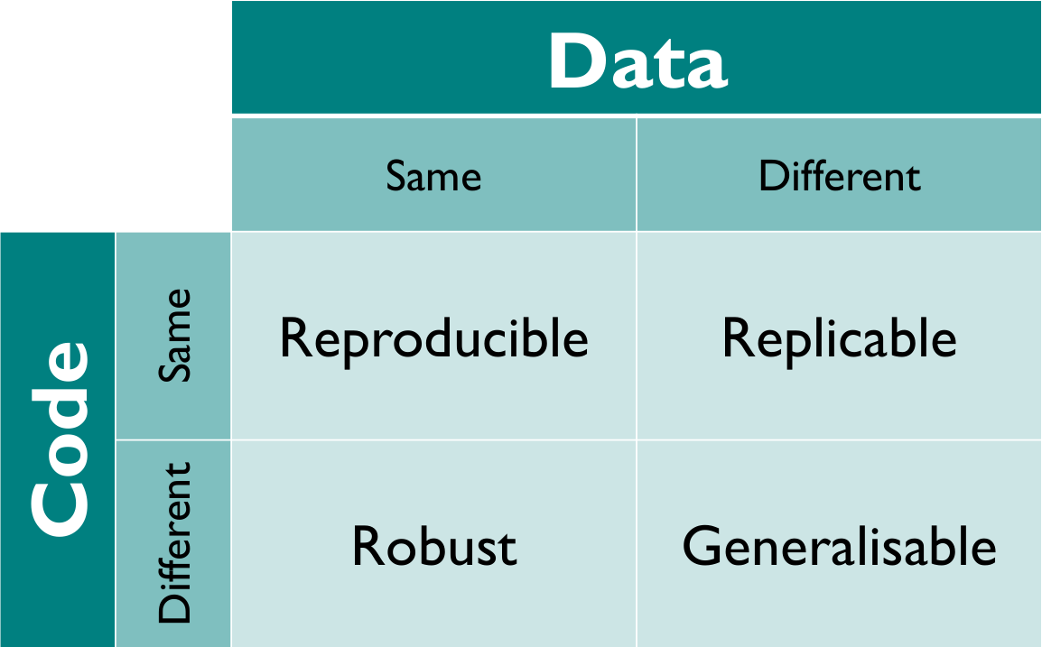
Software
Diagram by K. Whitaker is licenced under CC BY 4.0. DOI: https://doi.org/10.6084/m9.figshare.7140050.v2

Slide 64
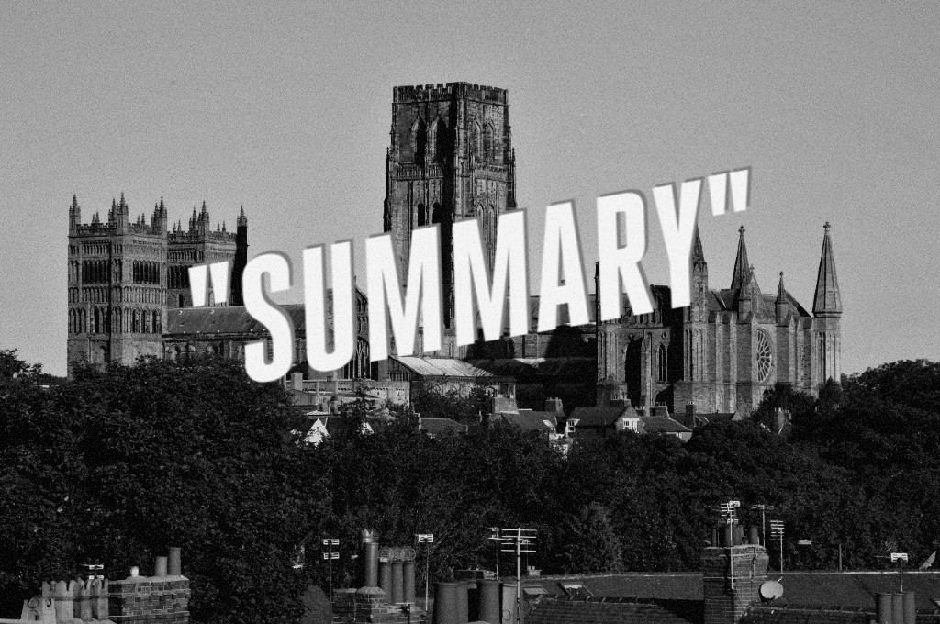
Image courtesy of Durham University.

Slide 65

Life-saving guidance

Slide 66
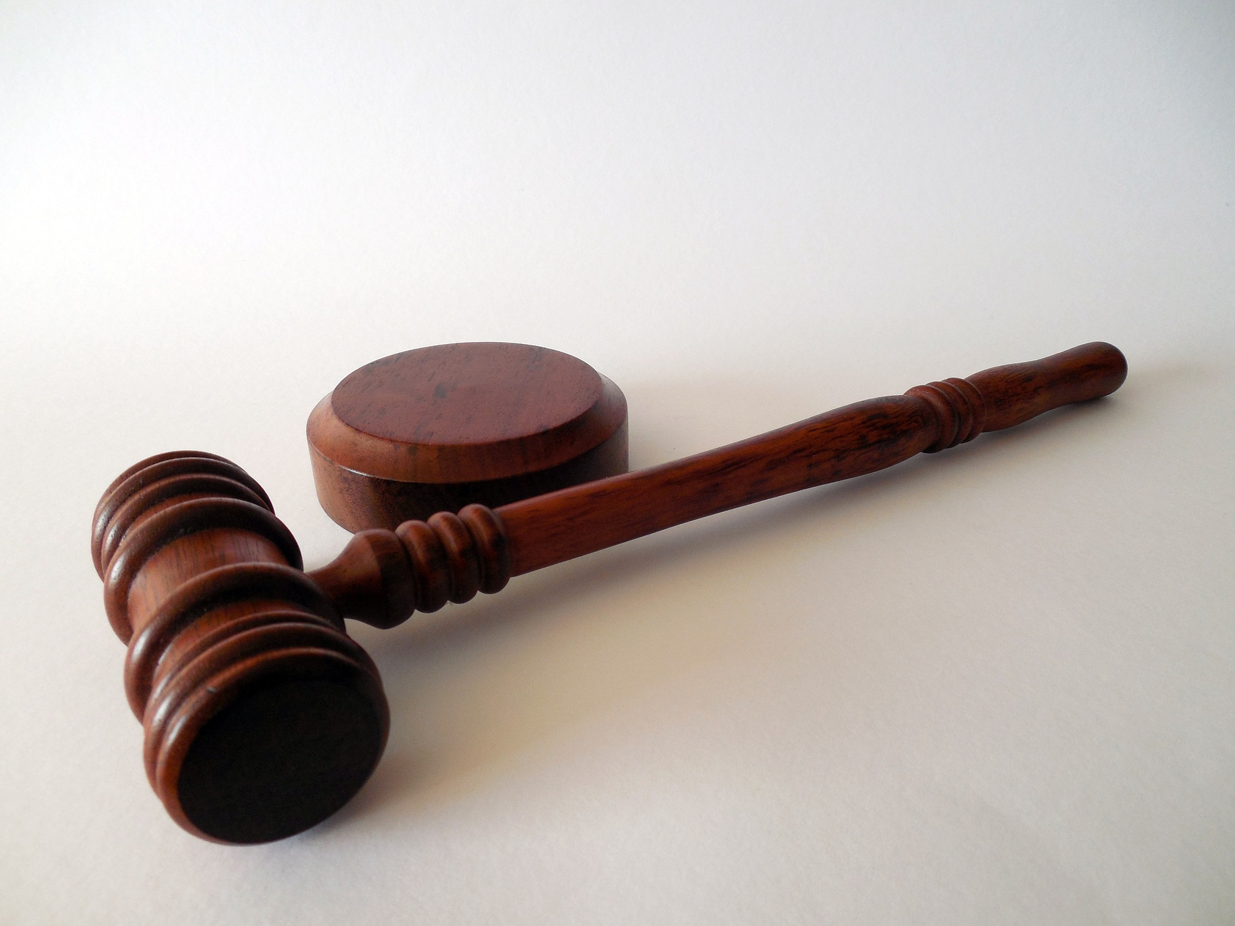
RDM rules of thumb

Slide 67

Online training
Research Data Management and Sharing MOOC (Massive Open Online Course): https://www.coursera.org/learn/data-management
MANTRA:
https://mantra.edina.ac.uk/
FOSTER e-learning platform
https://www.fosteropenscience.eu/

Slide 68
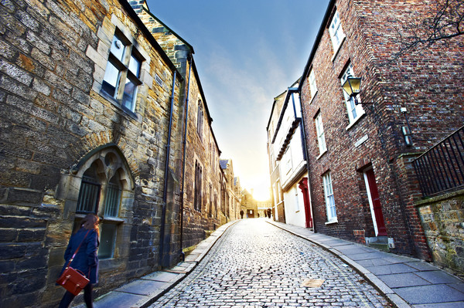

Thank you
Nicholas Syrotiuk
@DurhamRdm

Slide 69
References:
Vines, T. H., et al. (2014): "The availability of research data declines rapidly with article age," Current Biology 24(1): 94-97. DOI: https://doi.org/10.1016/j.cub.2013.11.014
Vines, T. H., et al. (2013): "The availability of research data declines rapidly with article age." Dryad Digital Repository. (dataset). DOI: https://doi.org/10.5061/dryad.q3g37
Michener, W. K. (2015): "Ten simple rules for creating a good data management plan," PLoS Computational Biology 11(10): e1004525. DOI: https://doi.org/10.1371/journal.pcbi.1004525
Piwowar, H. A., Day, R. S., & Fridsma, D. B. (2007): "Sharing detailed research data is associated with increased citation rate," PLoS ONE 2(3): e308.
DOI: https://doi.org/10.1371/journal.pone.0000308
Fear, K. M. (2013): Measuring and Anticipating the Impact of Data Reuse. Doctoral dissertation. University of Michigan. PID: http://hdl.handle.net/2027.42/102481

